Slide 1
Language Justice
Claire Frances
Director of the Center for Language and Culture Learning
Christine Shea
Associate Professor, Depts. of Spanish and Portuguese and Linguistics

Slide 2
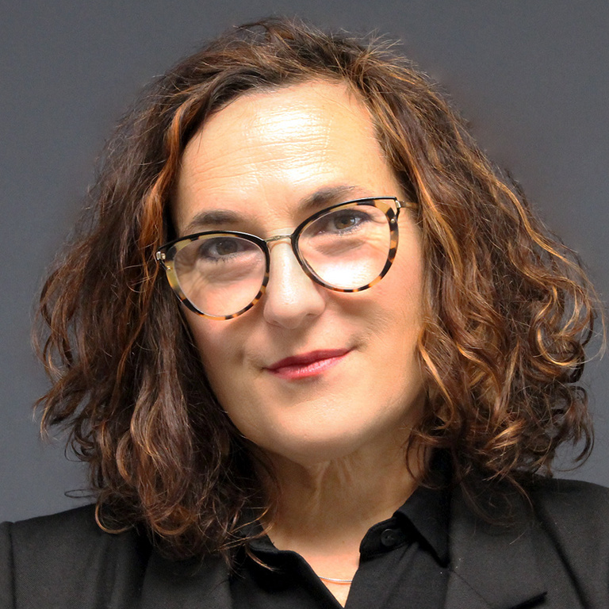
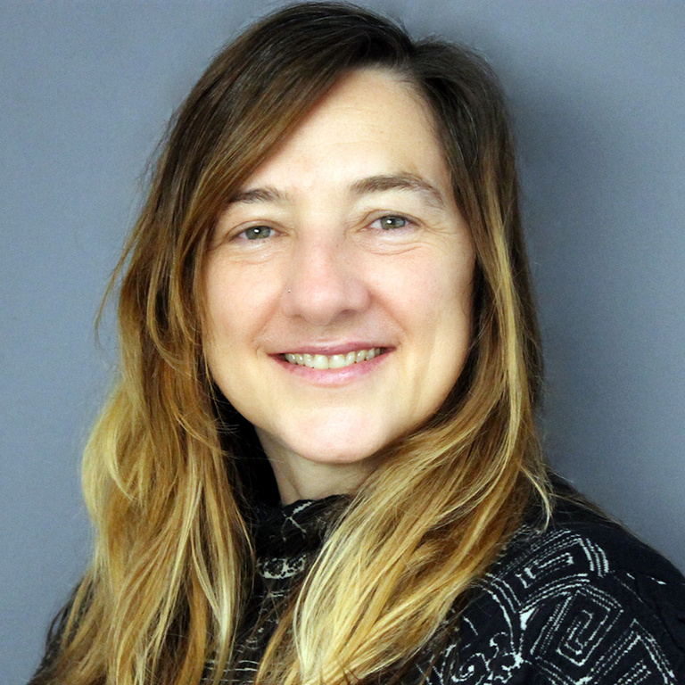
What brings us together
LANGUAGE

Slide 3
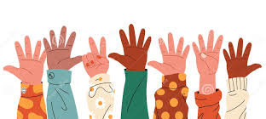
Goal of today’s talk
Gather together ideas and concepts related to language justice
  Some may be already familiar to you, some may be new
Clarify ideas and concepts around the notion of language justice
Be able to articulate and understand its importance
Understand how to evaluate the context for language justice in Dubuque
Explore preliminary ideas around implementation of language justice plans
  Discuss some of the measures you are taking now
  Discuss possible new measures for the future
Please feel free to ask questions or make comments at any point
Interrupt!

Slide 4
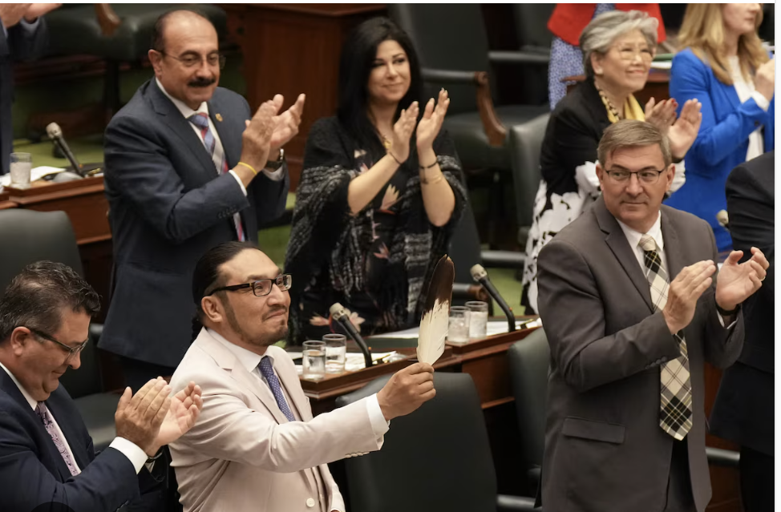
Language Justice from my hometown of Toronto
A historic event occurred Tuesday in the Ontario provincial parliament
For the first time since the parliament of Ontario was established in 1867, an indigenous language was spoken during one of its official sessions
Previously, the only permitted languages were English and French
The language was Anishininiimowin, or Oji-Cree
Language matters!
Language justice matters!
We are present, are heard and demand space with our language
Sol Mamakwa
New Democrat Party

Slide 5
Dubuque: A Small City with a Vibrant Language Ecology
source: All of us Dubuque https://www.allofusdubuque.com
Mayan: Families in Dubuque primarily speak Ixil, K’iche’ (Quiche), or Q’anjab’al (Kanjobal), and many arrive in Iowa being able to speak little or no Spanish
Marshallese: a Micronesian language spoken in the Marshall Islands, approximately 70-80 000 speakers
Other non-English languages spoken across Iowa:
French
Swahili
Lingala
Arabic
Meskwaki
Spanish

Slide 6
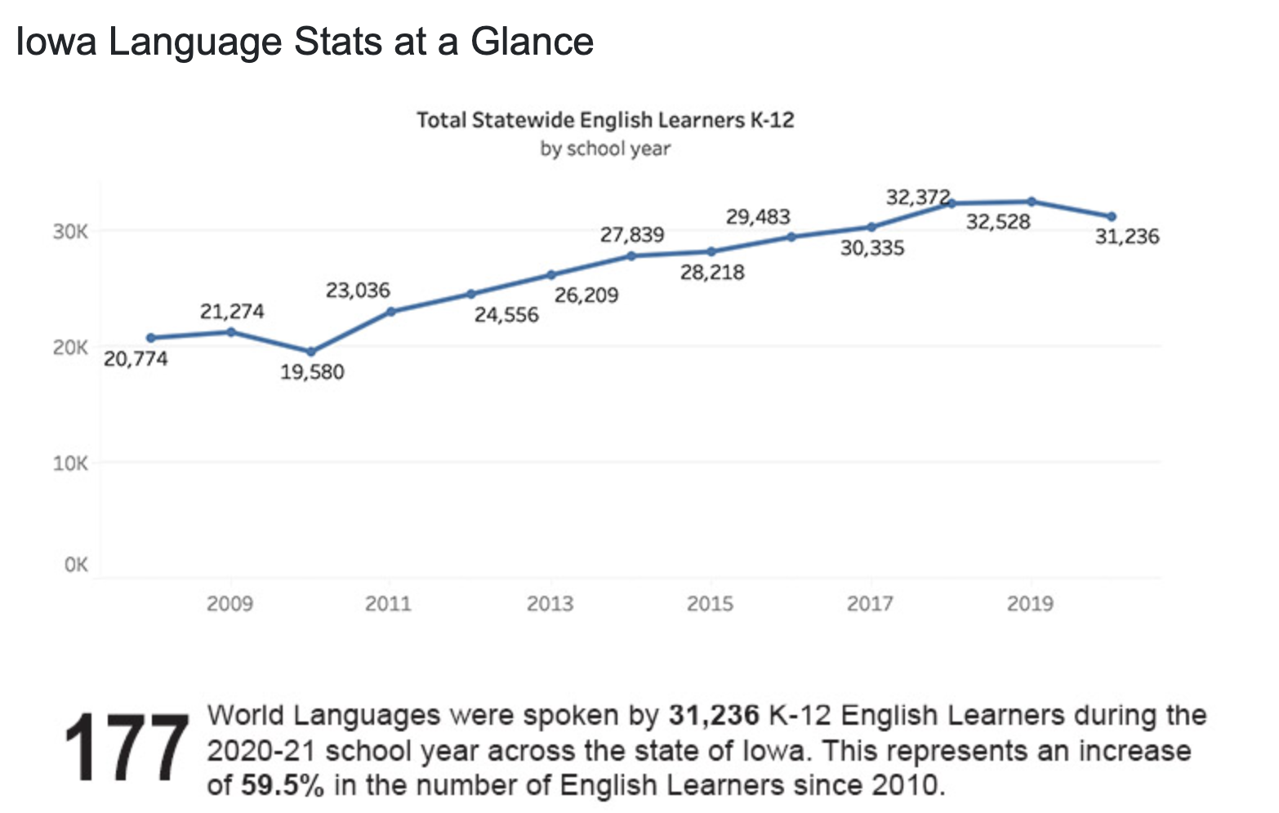
Demographics

Slide 7
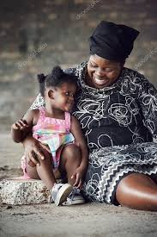
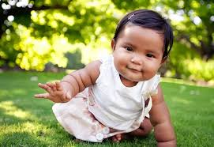
Why does language justice matter?
What is language justice?

Slide 8
What is language justice?
A political framework
An individual right
A collective orientation
A set of systems and practices

Slide 9
Language Justice impacts every facet of our community life
Language Justice
Health Care
Employment
Civic Participation
Access to Services
Housing
Education

Slide 10
What is language justice?
A concept and practice that seeks to ensure equal access, participation, and representation for speakers of all languages
Recognizes the power dynamics and inequities inherent in linguistic diversity and aims to address them through intentional actions and policies
power dynamics
linguistic diversity
intentional actions
policy

Slide 11
What does that mean?
Linguicism
A system of oppression based on language that results in structural advantages for dominant language speakers and disadvantages for non-dominant language users.
Although English is not an official language at the federal level, it is clearly the dominant language in the U.S., and all other languages are non-dominant.
“Language” does not have power
Power lies with those who speak the dominant language or language variety
Therefore, the existence of multiple languages or varieties means hierarchical relations among them
Some are on top and therefore, others on the bottom in terms of access to power (i.e., employment, education, health care, services, housing, etc.)

Slide 12
A language justice approach promotes crosslanguage collaboration, equitable communication, and language rights
A language justice approach also recognizes that language rights are human rights
Individuals can choose to participate in their preferred language
No language dominates, which means no group of speakers dominates
Language justice proactively prevents linguistic discrimination.

Slide 13
Standard Language Ideology
Lippi-Green (1997):
…standard language ideology is "a bias toward an abstract, idealized language …. imposed and maintained by dominant institutions …. drawn primarily from the spoken language of the (White) upper middle class."
In other words, the so-called “standard” we hold non-standards speakers to is based in social judgments, held up by those who have historically had access to power

Slide 14
Language is also power
  Certain languages have more power than others
  What does that mean?
    It is not the language (i.e., words, grammar, sounds) that has power but
    rather the people who speak it

Slide 15
Linguistic Power Hierarchy
Standard American English speakers

Slide 16



Standard Language Ideology
refers to the bias we all have (yes, ALL OF US) towards what we consider “correct” language
We are often not even aware that our actions and words reflect particular ideologies
David Foster Wallace's fish parable:
Morning, boys! How’s the water?

Slide 17
Standard Language Ideology
The most obvious realities are often the ones that are the most difficult to see
What the he** is water?

Slide 18
Language Justice: why does it matter?
IDENTITY
LANGUAGE
CULTURE
Language, identity and culture are intricately connected

Slide 19
Language Justice: why does it matter?
The language practices of groups that are disadvantaged are also typically the least valued by society
Language practice: ways of using language
  The ways disadvantaged groups use language are disparaged or valued as “less”
Questioning and resisting these systemic biases is the basis of the language justice framework (Piller, 2016)

Slide 20
Raciolinguistic Power Pyramid
The language we speak
is “heard” through the
way we look.
Racialized individuals
are heard differently
Even if their language
skills are objectively
advanced.
Standard American English speakers
Racialized English Speakers (African American English)
Racialized Non-English Speakers (Latinos, Asians, Africans)

Slide 21

Fight the Deficit perspective: Community multilingualism is an asset NOT A DEFICIT
Communicating in languages other than English is an asset
NOT a deficit
Just because a group is marginalized due to a certain characteristic (e.g., language), does not make the characteristic inherently deficient
Oppression against certain non-dominant language users is the problem
FIGHT LANGUAGE DEFICIT PERSPECTIVES!
Be an ally and an advocate!

Slide 22
Language Justice: why does it matter?
On a purely functional level, if individuals cannot communicate with the people who make decisions, they have no place at the table when those decisions are made
Being heard means having access to the process
We must ask ourselves, what do we stand to lose if we cannot directly hear the voices of all community members?

Slide 23
Aside… why might someone not speak English, even if they live in the United States?
“You have been here for how long? and you STILL do not speak English?”
Why is it problematic? How do we respond when we hear other people saying this?
do you know how hard it is to learn a language?
do you know how hard it is to learn a language when you are working 10 hours a day for minimum wage and have a family to look after?
how do I make it to classes? which classes? when? who will look after my family? who will make up for the work hours I have to miss?
My community speaks my language and I can get information from others
It is very, very hard to make English-speaking friends
My children speak English, they can help me
I am not fully literate in my native language, English classes require literacy
Anything else that I missed?

Slide 24
ENGLISH IS NOT A REQUIREMENT TO LIVE IN THE UNITED STATES.
second generation immigrants (i.e, children of new arrivals) all speak English
Moreover: our collective memory is short. 120 years ago, Germans were chastised for not learning English right here in Iowa
By the third generation, the family language (or heritage language) is often completely lost

Slide 25
Other communities
Language justice is also important for Deaf people
For neurodivergent people
For people who speak different dialects of English (Black English, African English, Indian English)
Their needs are different than those who speak non-dominant languages, but the principles are the same
Language Justice means all are heard

Slide 26
Language Rights within a Language Justice Framework
We all have the right to
communicate in the language(s) in which we feel most powerful and articulate
communicate in our own way, even when we are using the “same” language – Black English, Indian English, Appalachian English, etc.
be understood and allowed to fully participate as people with disabilities and neurodiversity

Slide 27
Language Justice: why does it matter?
Language Justice goes beyond just being able to be understood.
Implies a shift in how we think about our own language practices and those of others

Slide 28
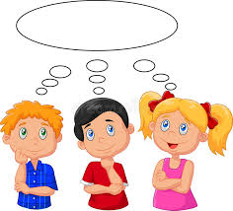
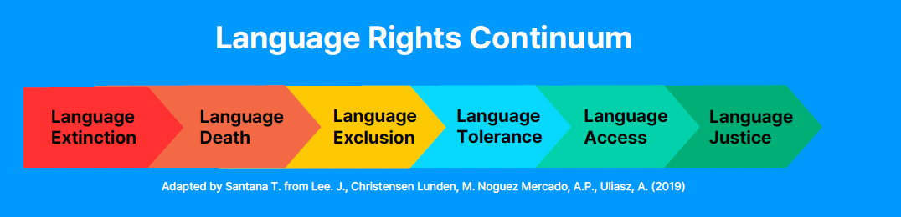
Language Rights Continuum
Where would you place your organization on this scale?
LANGUAGE
EXCLUSION
LANGUAGE
TOLERANCE
LANGUAGE
ACCESS
LANGUAGE
JUSTICE
Excluding people because they do not speak a language
Tolerating someone who speaks another language, without making any adjustments so that person can participante
Giving access to information, services to those who speak another language; usually English still dominates
Creating a space where people have language Access and there is a commitment to no language dominating

Slide 29
How do we move from Language Access to Language Justice?
LANGUAGE
ACCESS
LANGUAGE
JUSTICE
Develop a written policy document with concrete plans to serve individuals whose dominant language is not English
Use local data to inform your plan. Consult with community organizations, community groups, church groups, schools, stores, etc. to understand where community members live
Make hiring bilingual staff a priority.
Establish close, open and ongoing relationships with community groups.
Determine specific strategies and policies regarding how to respond to and ensure access at all points of contact from walk-ins, to phone calls, websites, written communication, etc. This must be written down and recognized as policy.
Appoint a language coordinator or working group. Ensure the coordinator has their other responsibilities reorganized so they have time and capacity to do the role justice.
Giving access to information, services to those who speak another language; usually English still dominates
Creating a space where people have language access and there is a commitment to no language dominating

Slide 30
How do we move from Language Access to Language Justice?
Update your plan on a yearly basis.
Questions to consider when updating:
» How have demographics changed during the last year?
» How has your plan affected your services?
» How did you respond to language needs as they arose?
» How did you address unexpected languages?
» What should you adapt or change for next year?
» How are you assessing and measuring client satisfaction?
» How are you building capacity in the long-term?

Slide 31
Inform the community in your service area about their rights to receive language support, that they are welcome in your organization, and about the inclusive services you provide.
Conduct regular trainings and activities to ensure that all staff are familiar with protocols for serving clients whose dominant languages are not English.
All staff should be empowered and should have the necessary information to use contracted remote (telephonic or video-based) services during emergencies and to communicate with walk-ins and callers
Staff should be properly trained to use a combination of on-site and remote interpreters, as appropriate, for ongoing cases and day-to-day work.
Have a budget for hiring experienced and qualified interpreters and translators.
Gather internal data and keep track of language needs

Slide 32
A Language Justice Action Plan
A Language Justice action plan shapes the way community members interact and advances equality and access for all
The goal is to move along the language rights continuum and eventually reach the ”Language Justice” outcome

Slide 33
Crucial: Planning and Evaluating With Community Members
Depending on community preferences, listening sessions, focus groups, or surveys can all provide useful input from community partners about what they believe to be barriers to and opportunities for expanding language justice
Community members must also understand their role: working with interpreters, right to speak up if interpreting is not helpful or if their needs have changed
Progress should be constantly evaluated and updated

Slide 34
Examples of implementation within an organization

Slide 35
Organizational/Community Scan
Training
Language Information
We use _______ to track the language preferences of community members.
We have designated a person to arrange/provide language justice training for all staff, interns, and volunteers.
All staff, interns and volunteers attend language justice trainings.
We know what languages the community members who come into contact with our organization use.
We know how many people use which languages in the community in which we work (demographic information)
We know where these communities live and what services are needed to work with them

Slide 36
Resources
Language justice is included in our budget and adjusted to meet the community needs on a yearly basis
We have a language justice coordinator within the organization to oversee our organization’s policy, protocols, practices and resources.
We have access to interpretation equipment.
Bilingual staff that provide language interpreting or translation are compensated fairly for their work.
Planning
We examine, promote, and incorporate language rights into our organization’s strategic priorities.
We define and discuss language justice in our meetings and events.
We include bilingual members, staff, and the interpreters we work with in creating our goals, strategy and otherwise providing leadership in our organization.

Slide 37
One more note… Community Translation
Translation services that come from training community members themselves
Translators are paid, valued, respected – not pulled from the audience ad hoc
Children should never translate for parents in sensitive contexts
Interpreting can be a tool of power
  who translates for whom
  what gets translated
  is the translator also part of the community? is the translator an activist?
  (vs. a paid contracted translator from the county/municipal government)

Slide 38
Summary: Key aspects of Language Justice
1. Equity and Inclusion:
All individuals can fully participate in social, political, and economic life regardless of the language they speak
Creating a space where where multiple languages are valued and respected.
2. Access to Information and Services:
Guaranteeing that essential information and services (e.g., legal, medical, educational) are available in multiple languages so that non-dominant language speakers can access them equally.
3. Recognition and Respect for Linguistic Diversity:
Valuing all languages and dialects, and resisting the dominance of a single language over others.
This involves promoting and preserving minority languages and cultures.
4. Community Empowerment: Supporting communities in maintaining their linguistic heritage and ensuring their voices are heard in decision-making processes.
5. Anti-Oppression Framework. Understanding and addressing how language intersects with other forms of oppression, such as racism, classism, and xenophobia.
6. Policy and Advocacy:
Influencing policies at institutional, local, and national levels to protect linguistic rights and promote language equity.
This includes advocating for multilingual education and language access laws.

Slide 39
Language justice is practiced through a variety of methods, including:
Bilingual and Multilingual Education
Interpretation and Translation Services
Language Access Plans
Cultural and Linguistic Competency Training (educating individuals and organizations about the importance of language justice and how to implement it)

Slide 40
Closing (but not concluding)
Consider the practical steps we mentioned here to weave language justice principles into your services and advocacy
We are always available for consultation, assistance and help
In fact, both Claire and I are fully and firmly committed to these principles and look forward to supporting you in your efforts
(which are already extensive)

Slide 41
Summary and a few key concepts and terms
Standard Language Ideology
Non-Deficit perspective
Language Justice
Non-dominant language speakers (vs. non-native English speakers)
Response to “You have been here for how long? and you STILL do not speak English?”
Linguicism

Slide 42
Key terms
Language Access: The use of language assistance that incorporates different tools and strategies (e.g., bilingual staff, interpreting, translation, signage, outreach, and evaluation) to ensure that non-dominant language users have access to critical services, programs, and civic participation.
Language Justice: The systematic fair treatment of people of all language communities and respect for everyone’s fundamental language rights.
Language Rights: The human and civil rights of linguistic groups, such as the right to preserve non-dominant languages, access critical services without language barriers, and to live free from linguistic discrimination in education, workplaces, civic participation, and all other contexts.
Meaningful Access: The U.S. Department of Justice defines meaningful access as, “Language assistance that results in accurate, timely, and effective communication at no cost to the LEP individual. For LEP individuals, meaningful access denotes access that is not significantly restricted, delayed or inferior as compared to programs or activities provided to English proficient individuals.”

Slide 43
Questions or Comments?

Slide 44
Thank you
christine-shea@uiowa.edu
claire-frances@uiowa.edu

