Slide 1
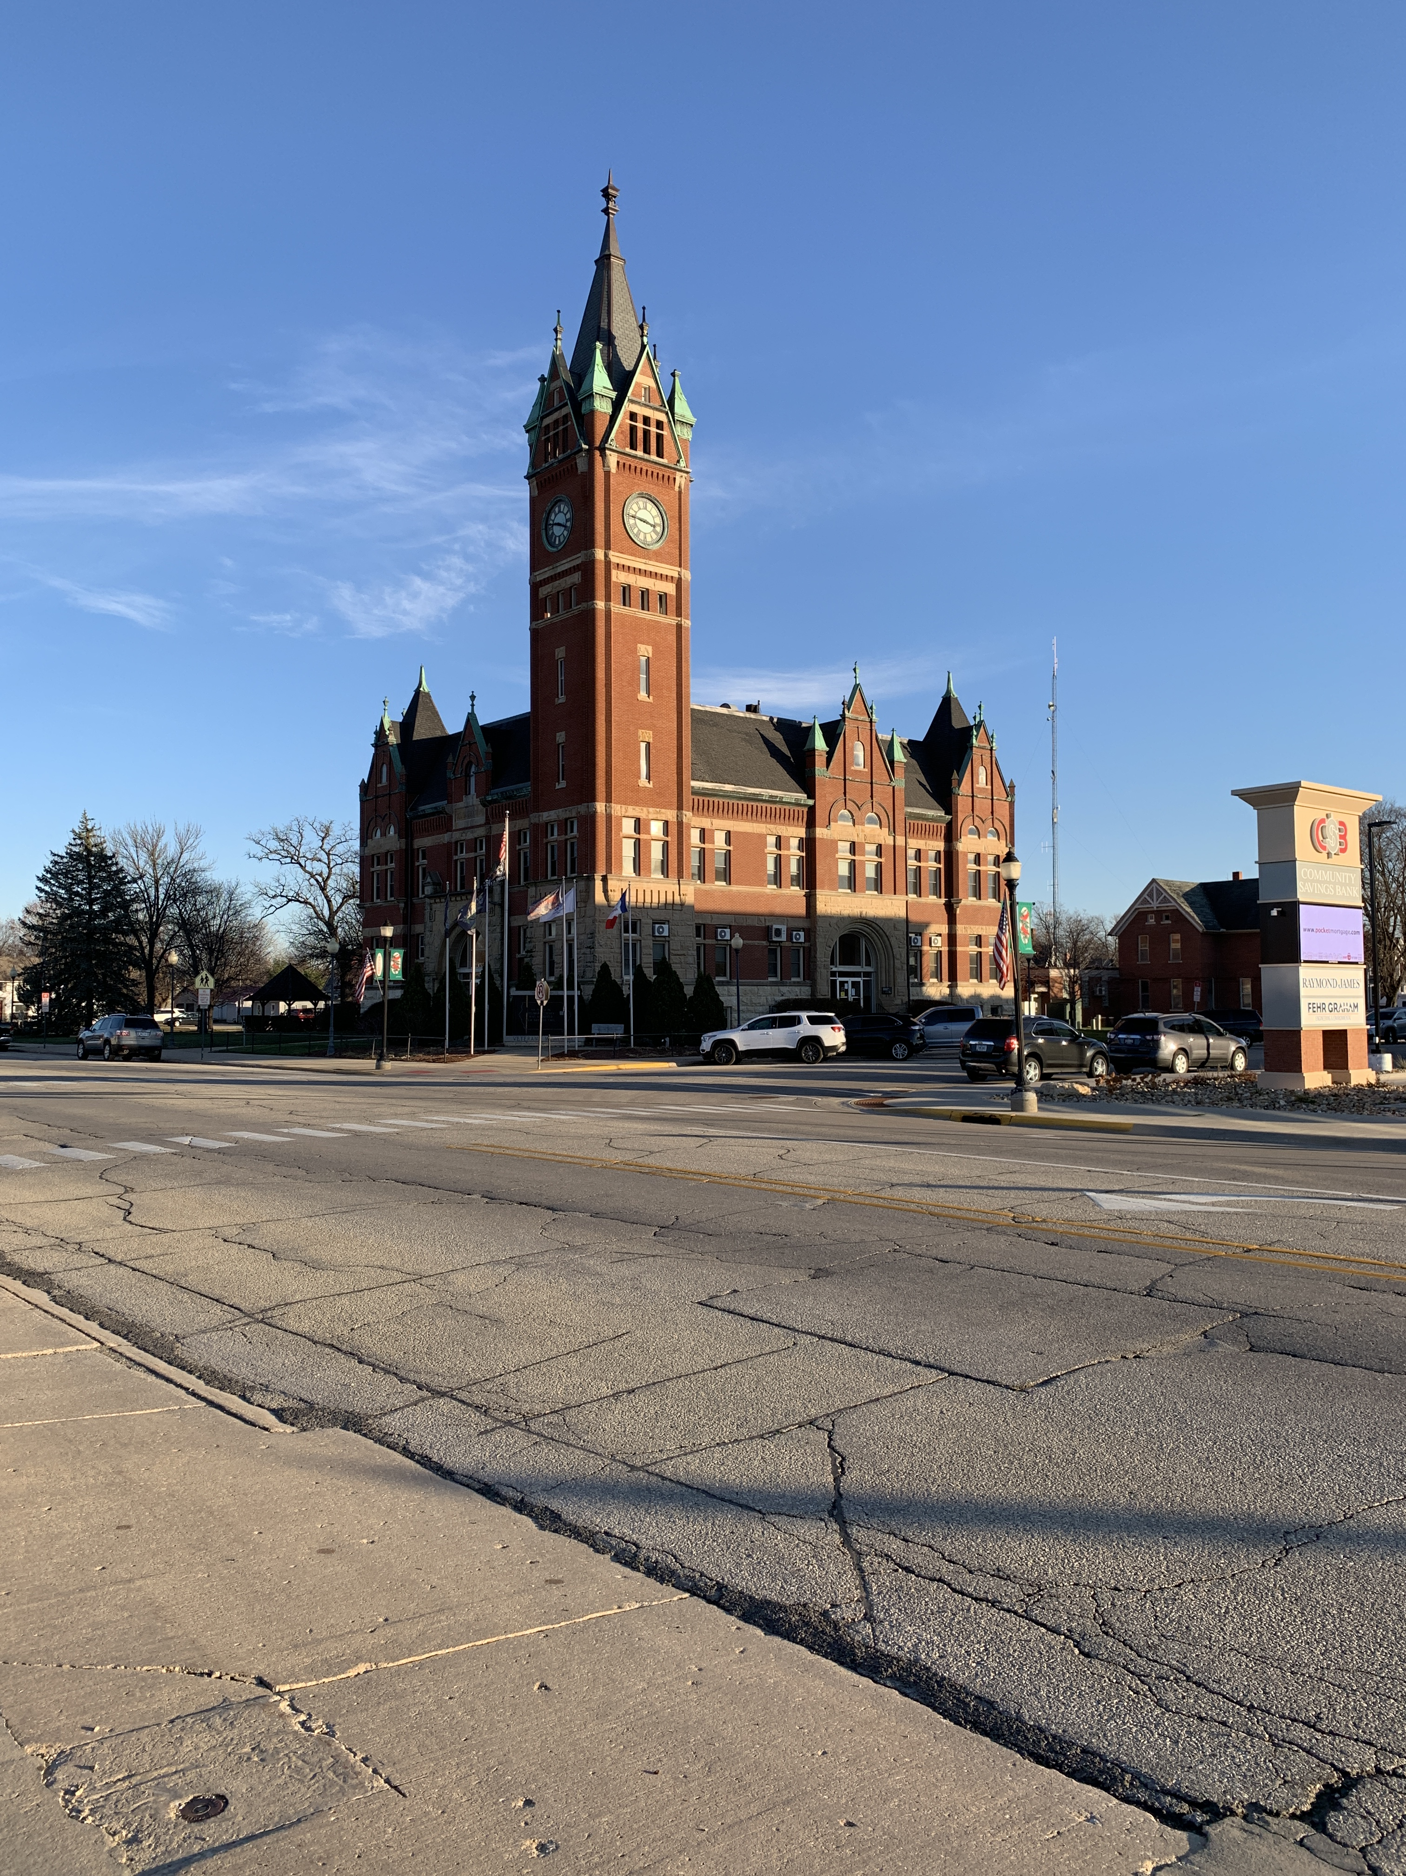
Manchester
Strategic Growth Plan
2021

Slide 2
OUTLINE OF THE PRESENTATION
1
2
3
4
5
6
7
8
Outline of the Presentation
1
Acknowledgements
2
Timeline
3
History/Profile
4
Planning Process
5
Community Engagement
6
Infill Development
7
Annexation
8
Extraterritorial Zoning

Slide 3

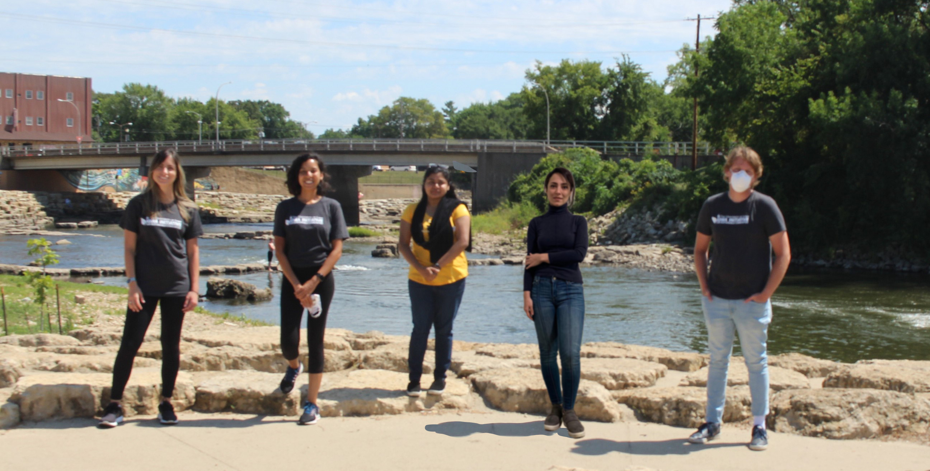



Acknowledgements
1
2
3
4
5
6
7
8
Planning Team
Flavia Hauss
Jack Johansen
Nafisa Binti
Parya Seif
Shila de Morais
Travis Kraus, Associate Professor
Phuong Nguyen, Associate Professor
Haifeng Qian, Associate Professor
Tim Vick, City Manager
Travis Kraus, Director

Slide 4










Timeline
1
2
3
4
5
6
7
8
Site visit
Preliminary Research
Data Analysis
Framework
Methodology
Stakeholders
Extraterritorial Zoning Map
Population and Physical Growth Scenarios
Strategies and Recommendations
Final Semester Report
Revise design and content of the plan
August
September
October
November
December
January
February
March
April
May
Vision, scope, purpose
Community profile
History and Growth overtime
Community Engagement
Cost of Annexation
Land Use, Floodplain and CSR Analysis
Fiscal Impact Analysis
Infill Development/Redevelopment
Growth Trend Identification
Expert Interviews
Strategies and Recommendations;
Final Plan

Slide 5


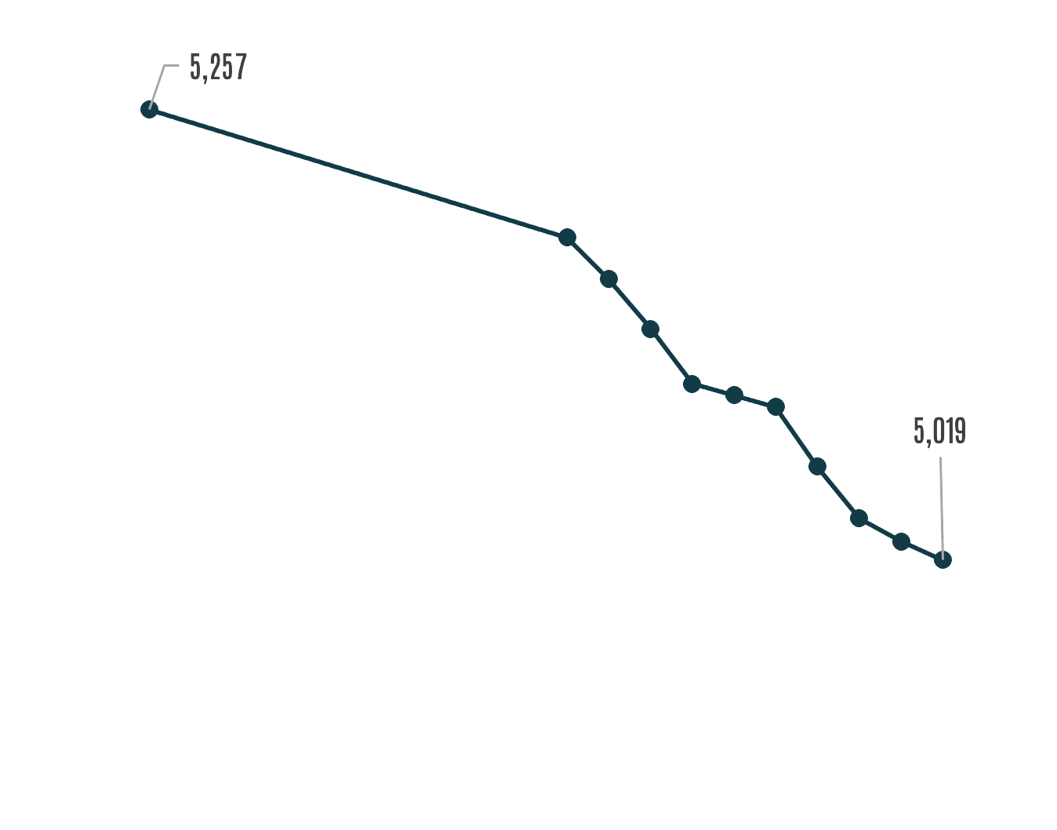
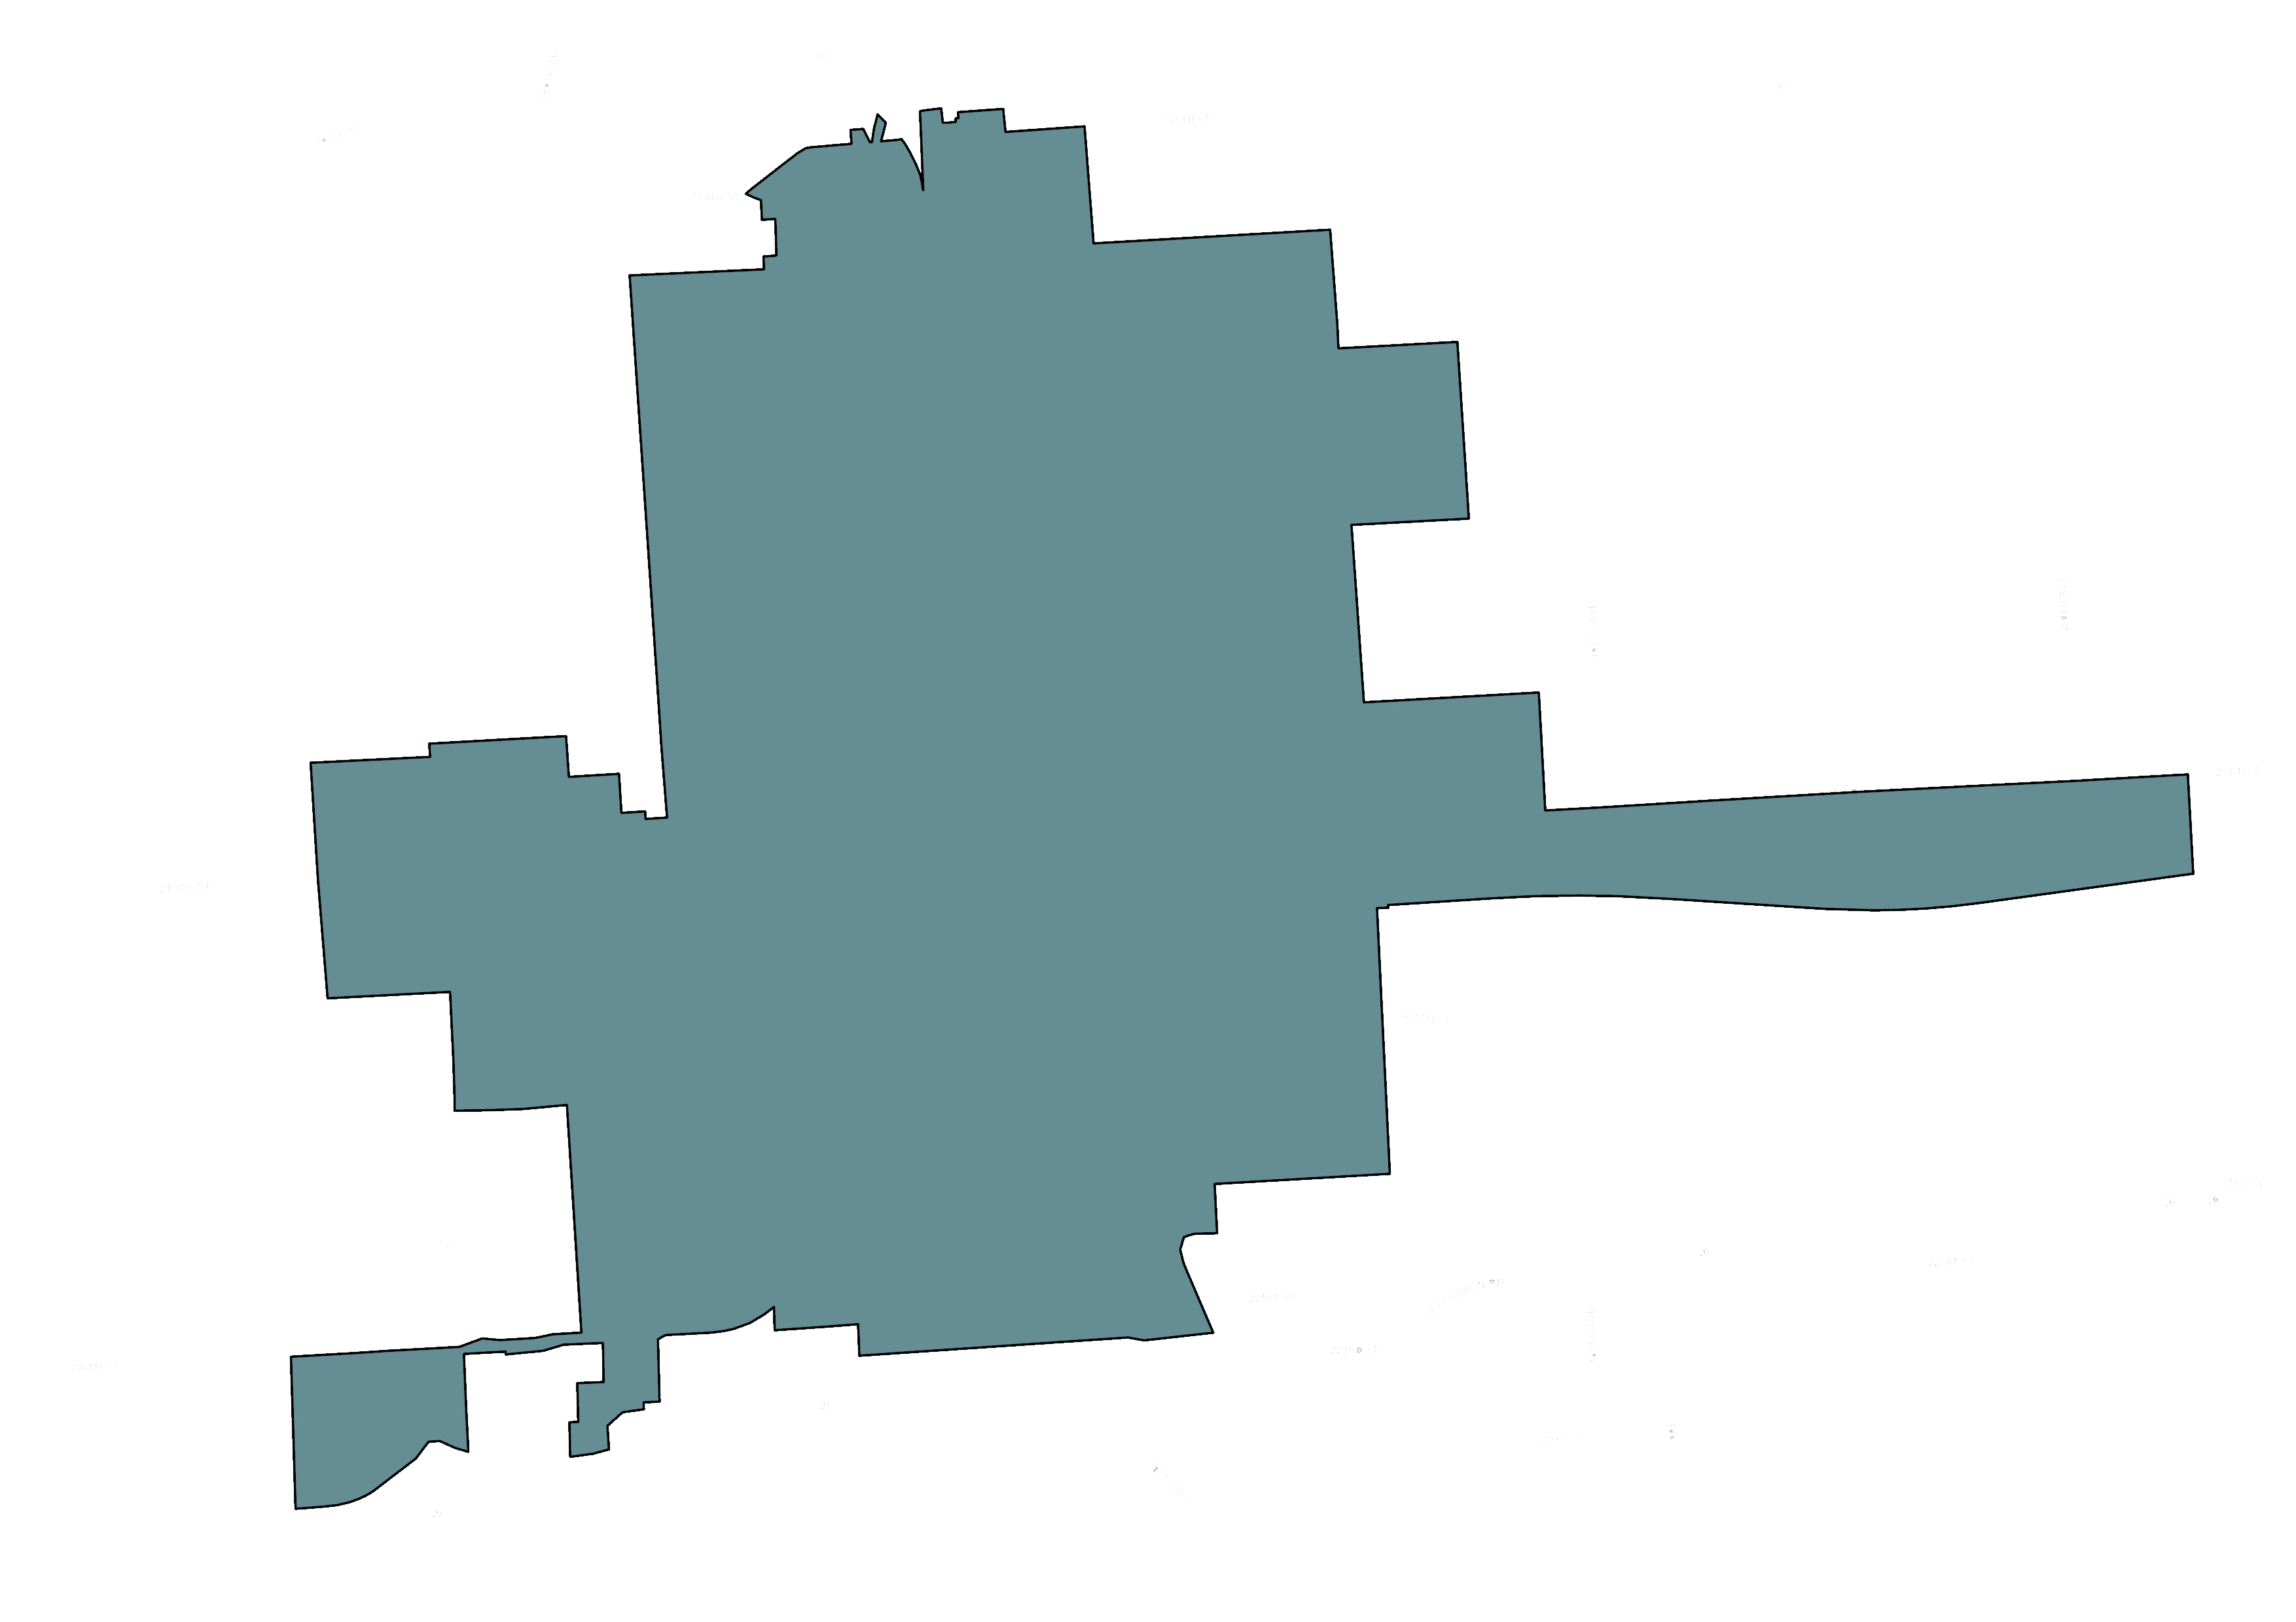
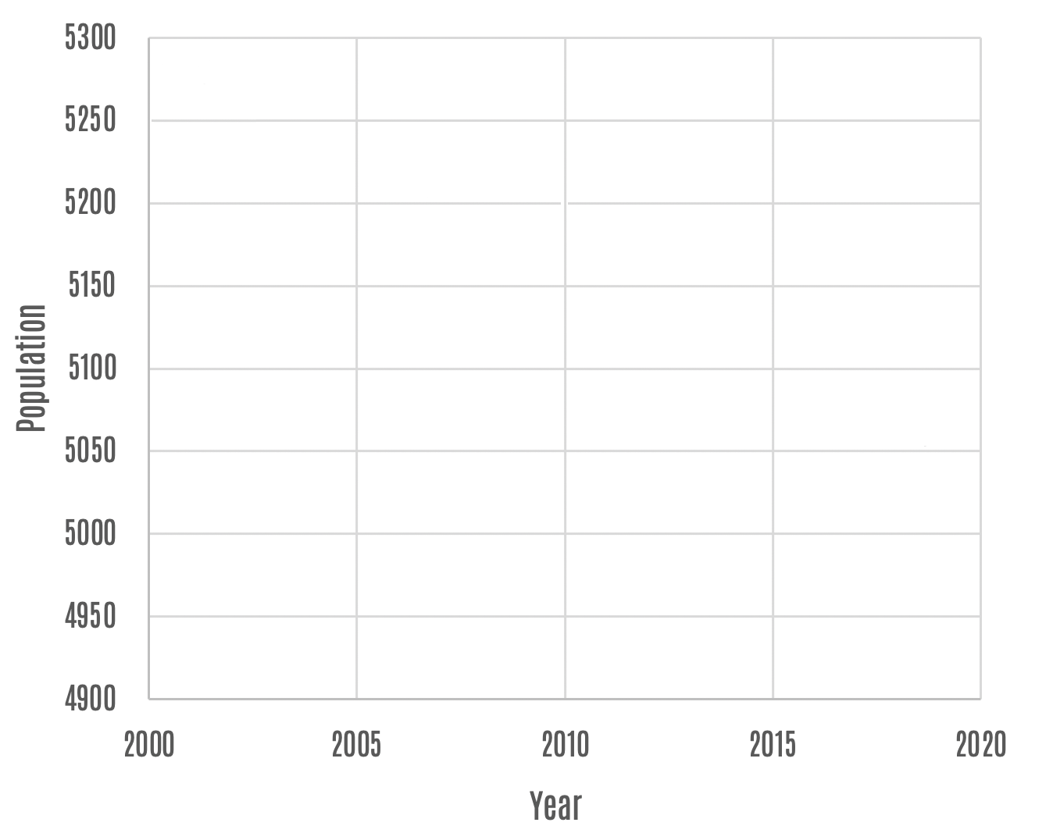
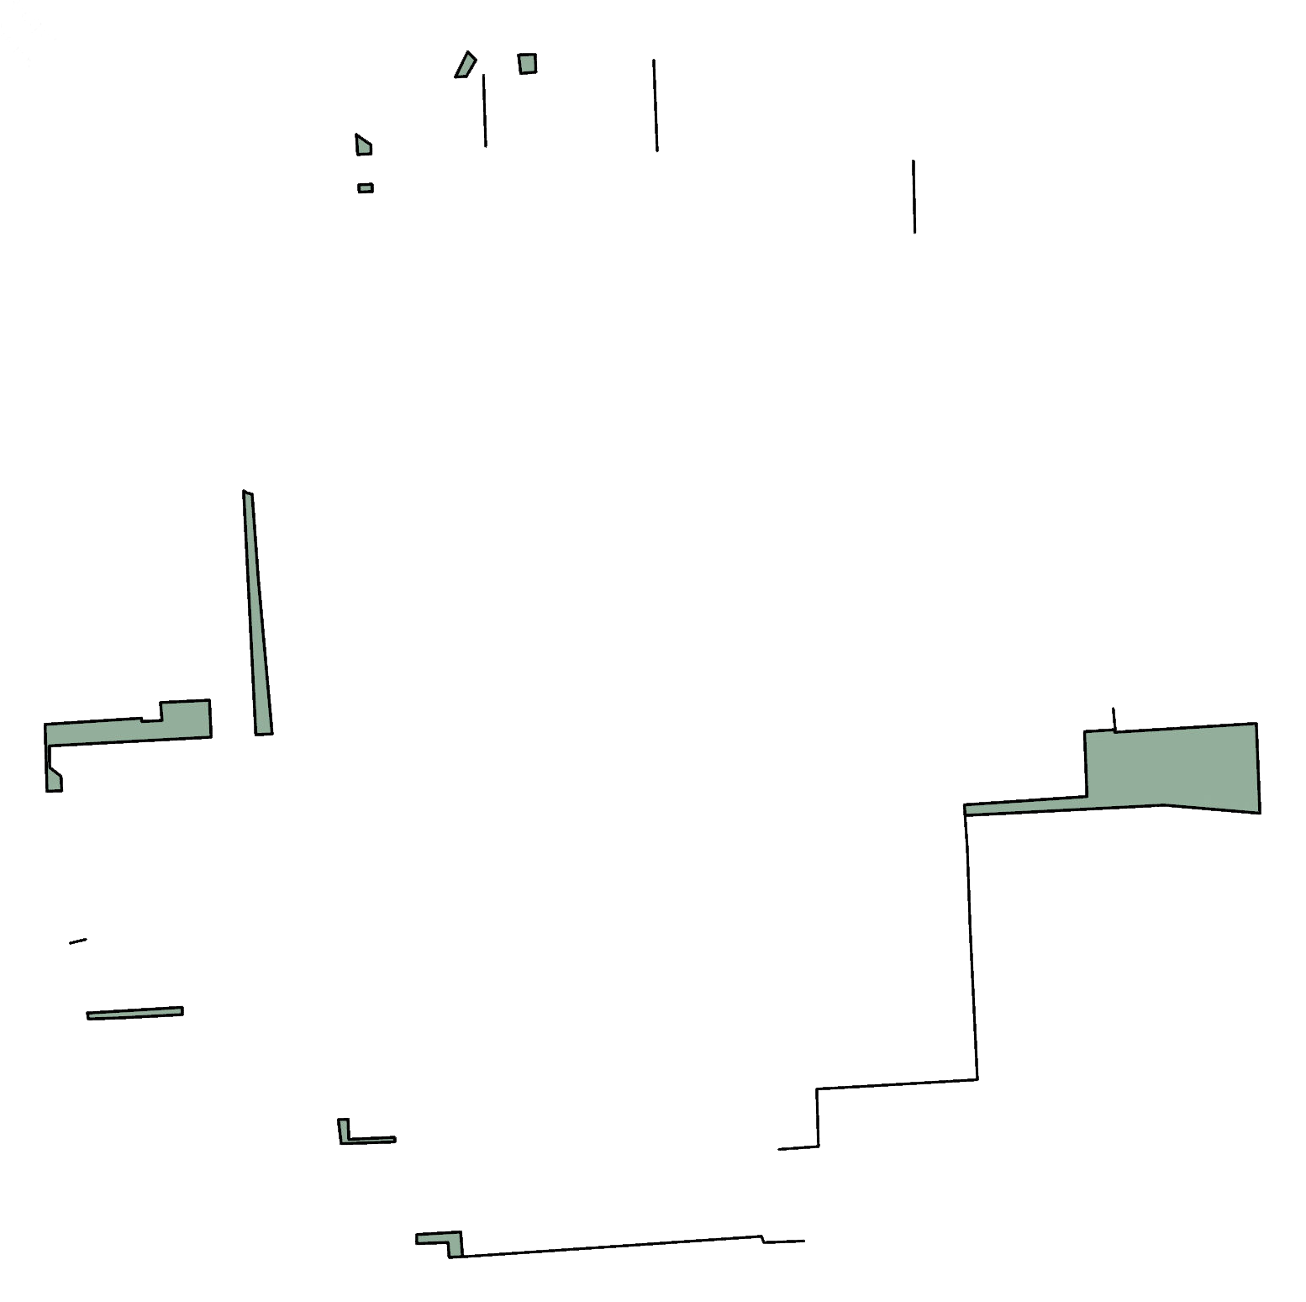
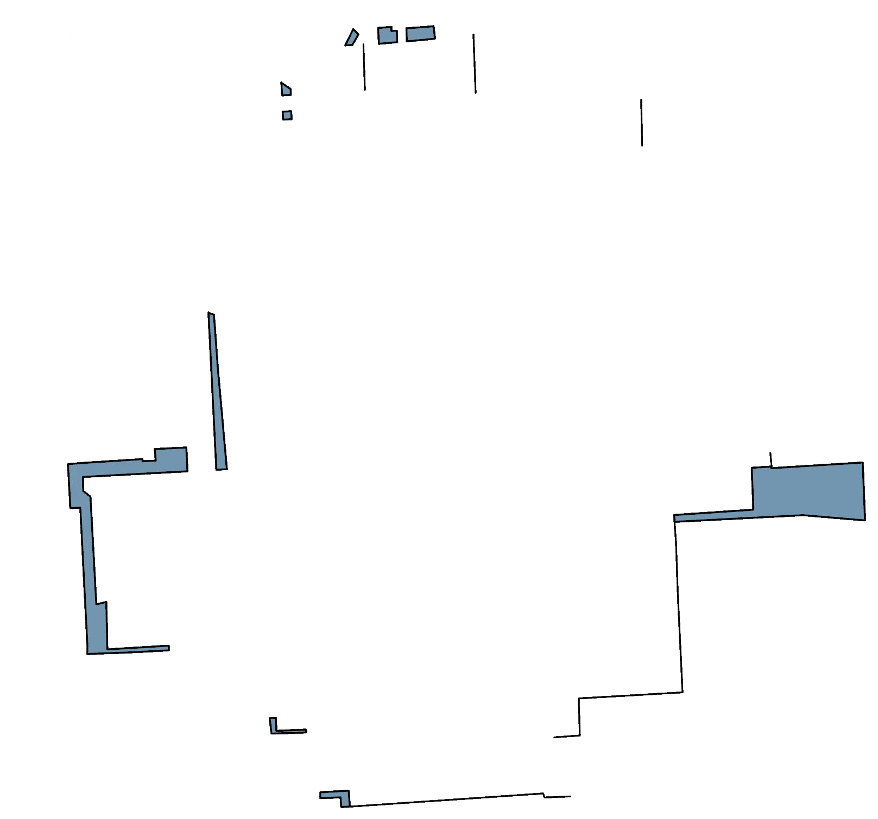

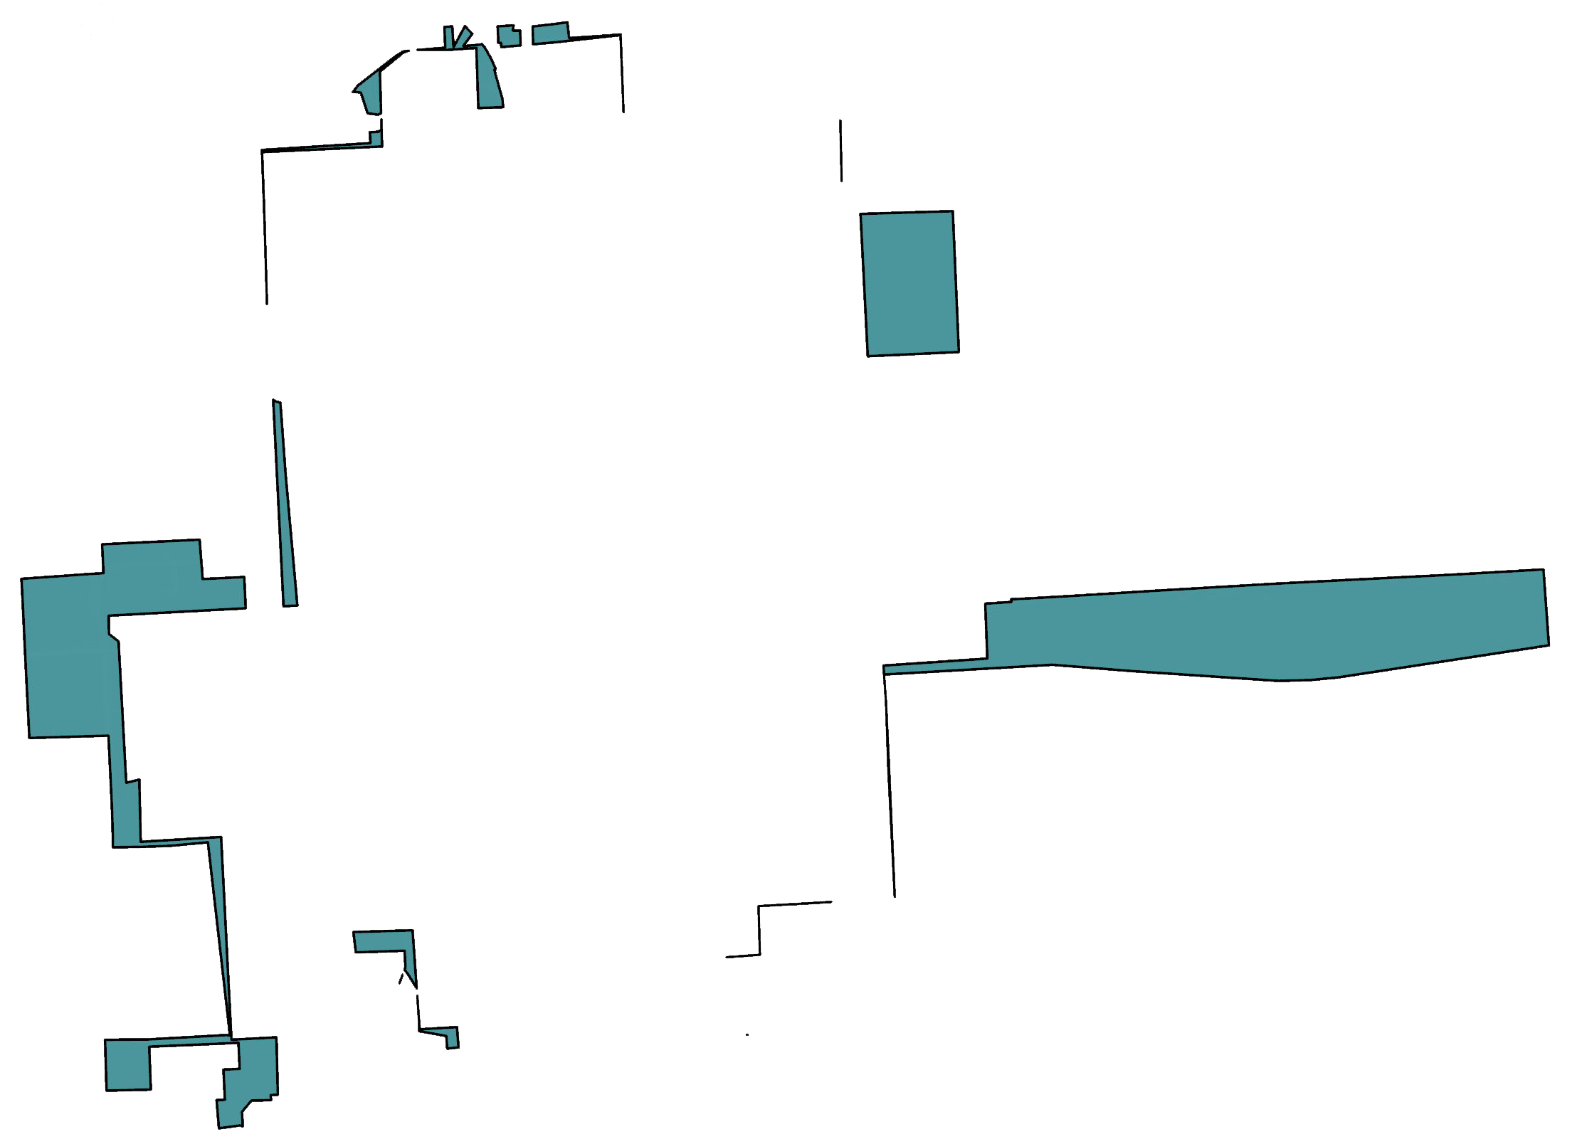
Main Topics from Past Presentation
1
2
3
4
5
6
7
8
History and
Growth Patterns
Demographics
Manchester population from 2000-2019. Source: Census and ACS
1980
1990
2000
2010
2020
Manchester’s population trend

Slide 6
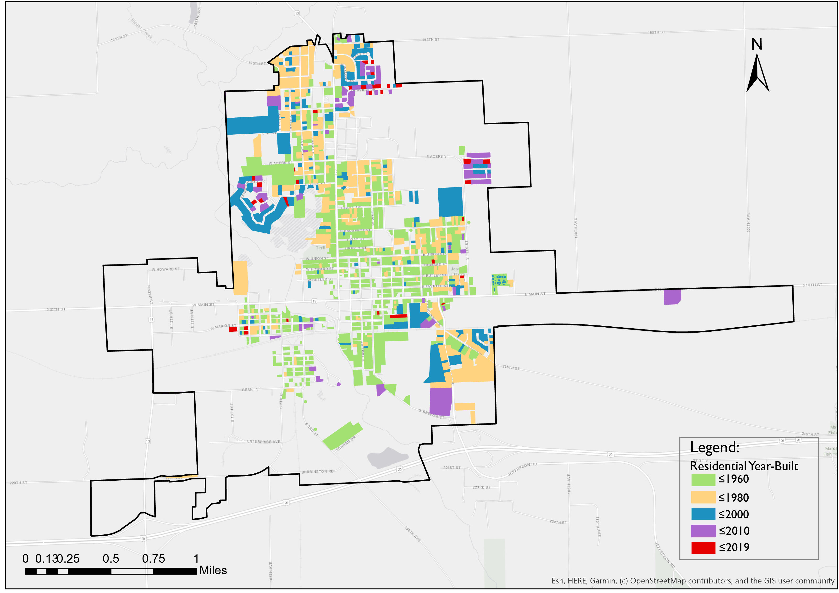
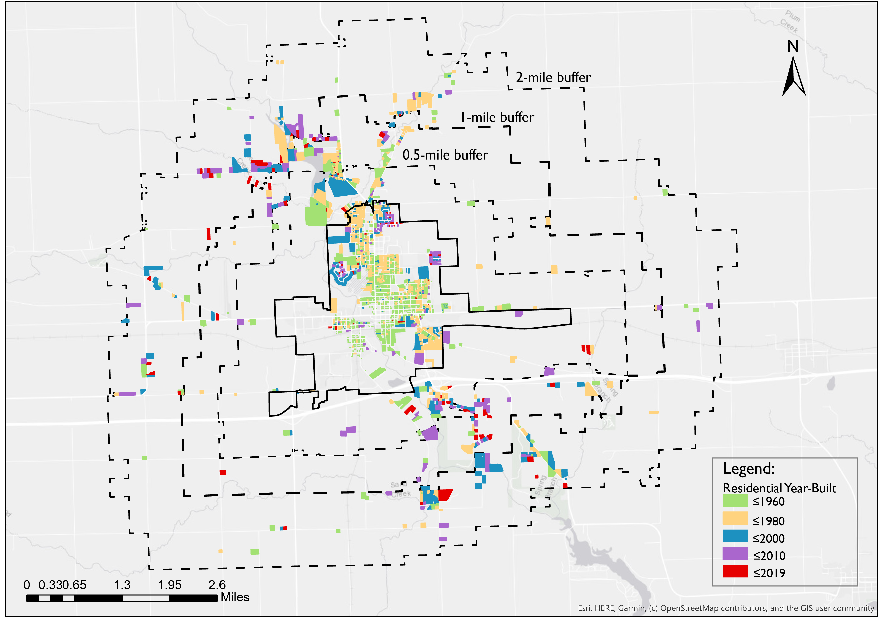
Challenges
1
2
3
4
5
6
7
8
92% of total housing stock was built before 2000
Around 44% was built more than 70 years ago
7.6% of housing units were built in the last 20 years
32% of the total housing units outside of the city boundary were built after 2000
Source: Assessors Office, GIS Analysis performed by Authors

Slide 7
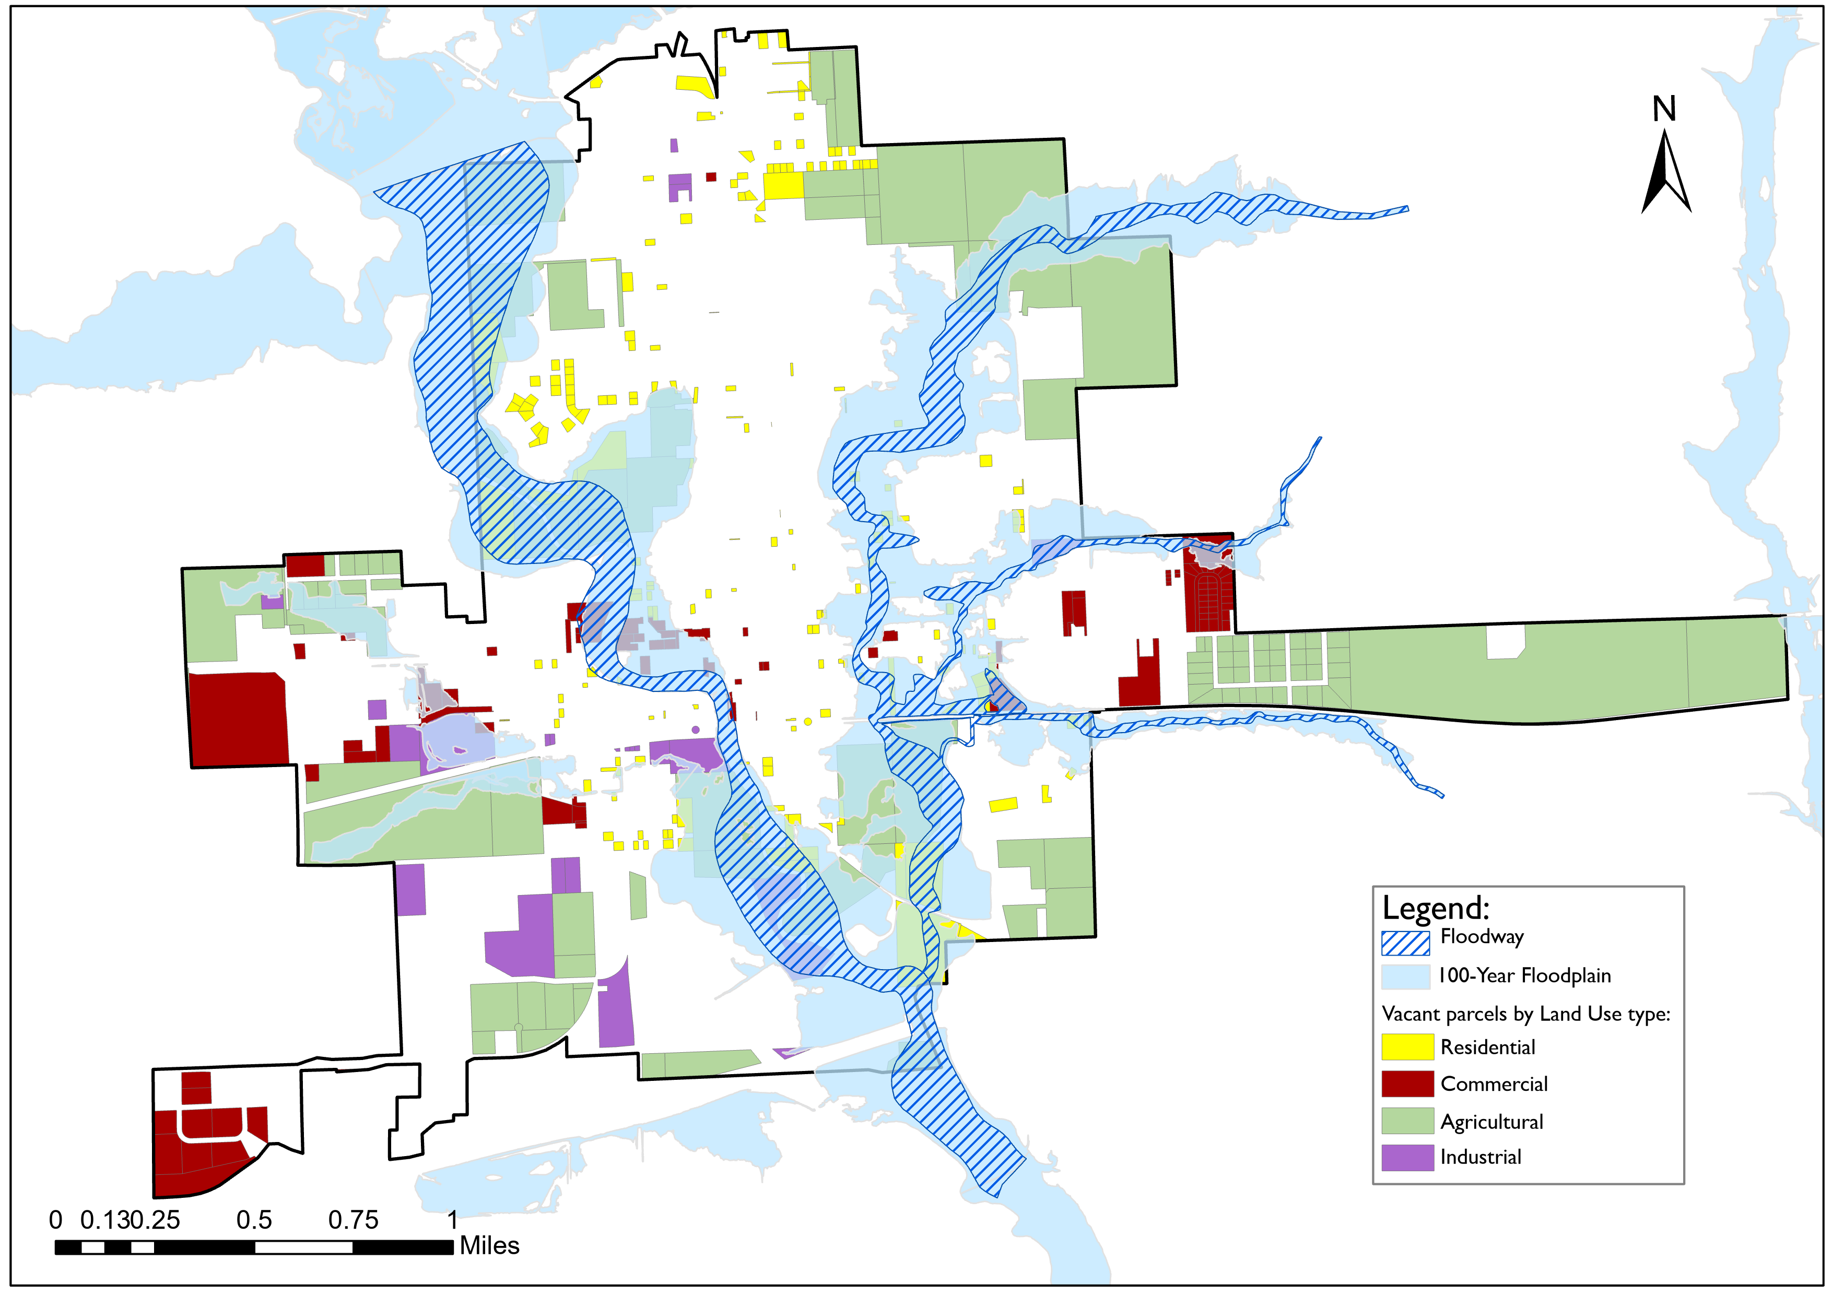
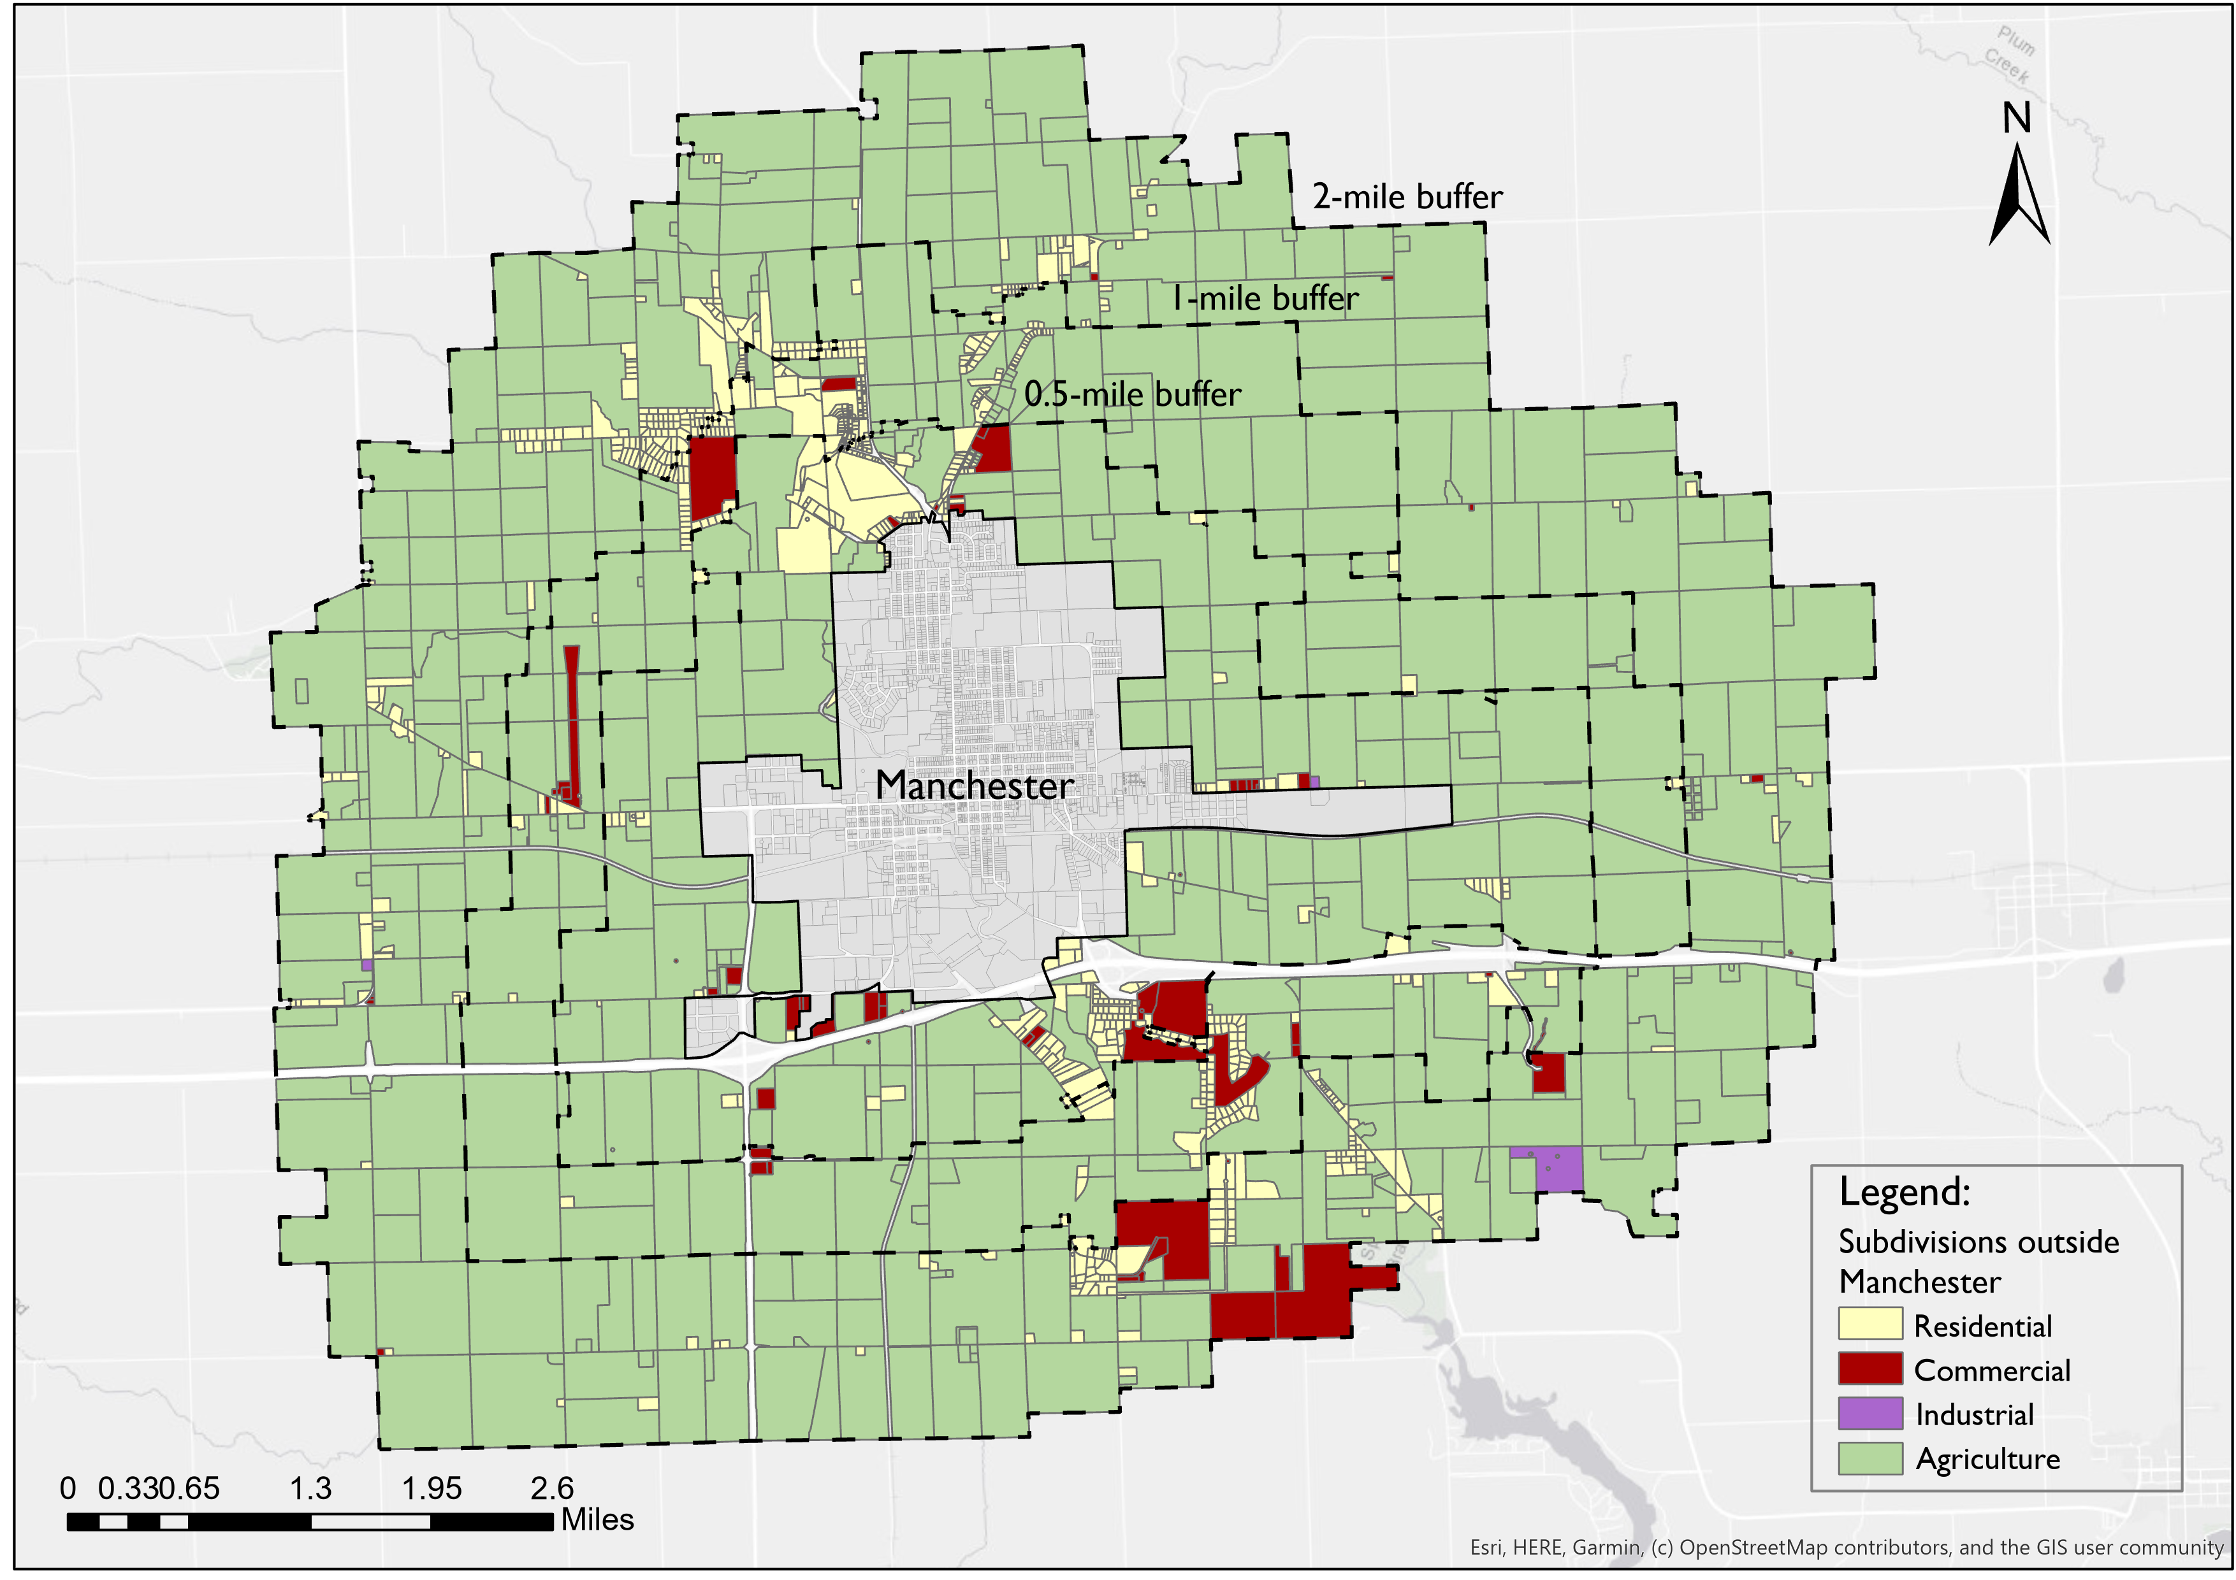
Challenges
1
2
3
4
5
6
7
8
1
Parts of the available land within the city are not suitable for development
2
Development of subdivisions outside of the city’s boundary
Source: Assessors Office, GIS Analysis performed by Authors
Source: Assessors Office, GIS Analysis performed by Authors
Notes:
Disorganized development due to lack of Zoning Ordinance in Delaware County
Unregulated development becomes inefficient for extending city services, utilities, and roads.
Development might occur in agricultural land with high Corn Suitability Rate (CSR
Development might occur in the floodplain which puts those properties at risk
Potential for concentrated animal feeding operations (CAFOs) developing close to residential areas
Developments along highway 20 could make Manchester look unattractive
Lack of control around the city may lead to inefficient low-density pattern of growth

Slide 8
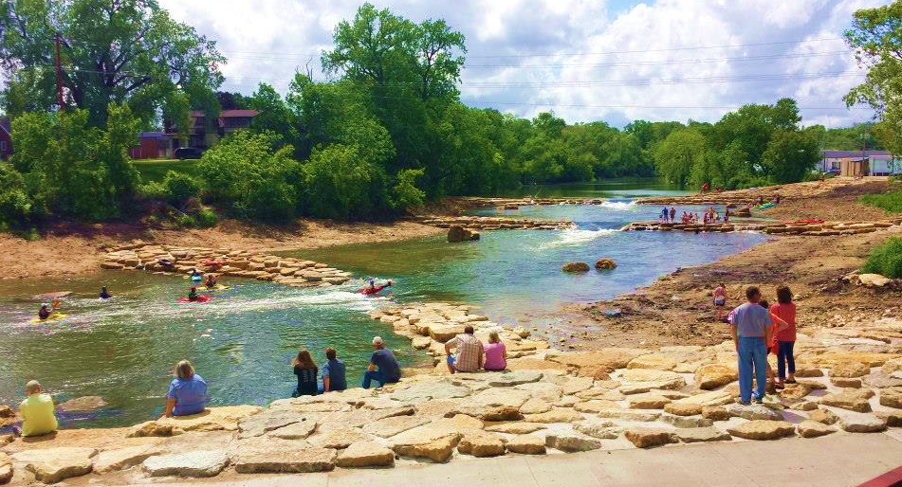
Manchester provides ample opportunities for growth while optimizing land use and adhering to principles of sustainability.
VISION

Slide 9
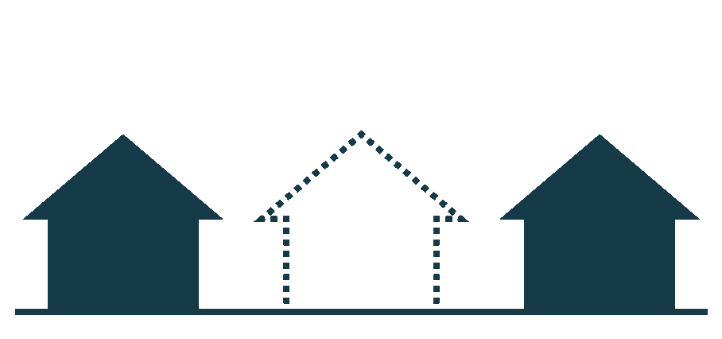

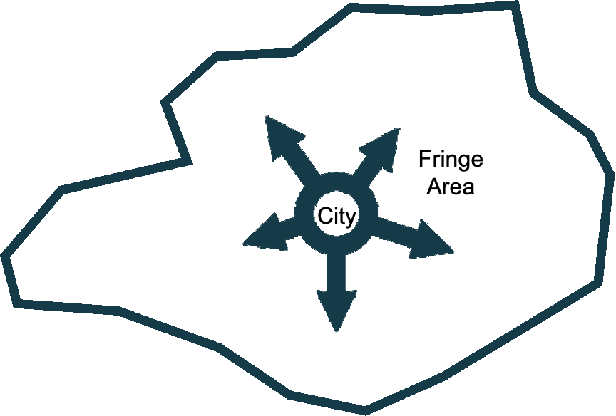
Scope
1
2
3
4
5
6
7
8
Sustainable design;
Infill Development and Redevelopment
5-10 years
Housing Diversity;
Community character;
Annexation
Scope
Emphasize on the Importance of Having Extraterritorial Zoning

Slide 10



Purpose
1
2
3
4
5
6
7
8
Sustainable design;
Sustainable Growth
Encourage Infill Development and Redevelopment within the city boundary
Ensure that new development does not exacerbate flood problems
Housing Diversity;
Efficient Use of Public Funds
Community character;
Decrease costs to the public by optimizing the capacity of existing infrastructure
Guide the city in decisions on future annexations
Purpose
Conservation of Farmland and Open Spaces
Prevent sprawl by focusing on organized development patterns
Protect prime farmland and natural resources from development

Slide 11










Methodology
1
2
3
4
5
6
7
8
Strategic Planning
1
2
3
4
Gathering Initial Information
Public Engagement
Strategies and Actions
Analysis
Site Visit
Community Workshop
Spatial Analysis
Infill Development
Past Planning Efforts
Survey
SWOC Analysis
Annexation
Iowa Law Documents
Website
Fiscal Impact Analysis
Extraterritorial Zoning
11

Slide 12

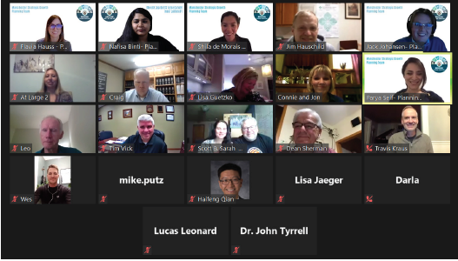

Community Engagement
1
2
3
4
5
6
7
8
2
Methodology
1
Survey
3
Community
Workshop
Website
Meeting with Manchester residents
Survey distributed to Manchester residents
Website created by Planning Team
Survey distributed to half-mile buffer residents

Slide 13



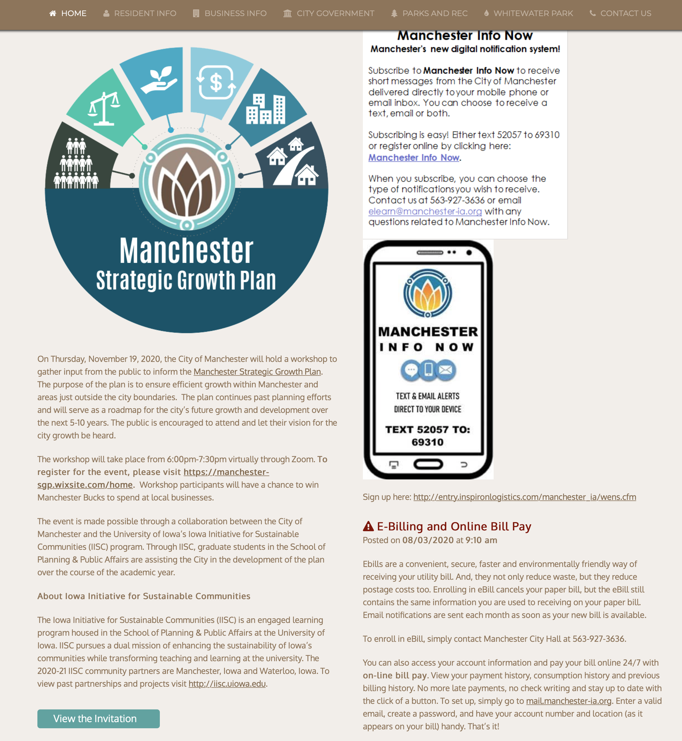






Community Workshop
1
2
3
4
5
6
7
8
Advertisement
Press Release
MSGP Website
Website
Flyers
City’s Website
Radio
Personally distributed
Digital

Slide 14






Community Workshop
1
2
3
4
5
6
7
8
Purpose
Perception of Manchester
(highway 20)
Public Safety
Community Needs
Development Density Preferences
Importance of Diverse Population
Benefits of Living in Manchester

Slide 15




Community Engagement
CONCLUSIONS
THE RESULTS FROM THE PUBLIC ENGAGEMENT INFORMED THE PLAN TO PURSUE THE FOLLOWING ACTIONS
Need for Housing/Affordable Housing
Higher Densities
Willingness to relocate from floodplains

Slide 16






Infill Development
1
2
3
4
5
6
7
8
PURPOSE
Identify Vacant and Suitable Lands
Accommodate Projected Housing Demand
“Developing on vacant or under-used parcels within existing urban areas that are already largely developed”
Prevent Developments in Floodway/Floodplain
Use Existing Infrastructure Efficiently
Source: Parcels located outside floodplain that are best suited for development
Notes:
This section will focus on the constraints and opportunities for development within Manchester. It will focus mainly on the need to preserve Floodplains and land with high Corn Suitability Rates (CSR).

Slide 17






Infill Development
1
2
3
4
5
6
7
8
Projected Housing Demand Study
Existing housing need
General Occupancy Product Type
Reduction in new building permits
173
Limited vacancy rates in senior housing
Need for affordable housing
Age-Restricted Product Type
242
Ability to pay for housing
Projected Housing Demand
415
Comprehensive Housing Demand Study 2015, Maxfield Research Inc.
Notes:
This section will focus on the constraints and opportunities for development within Manchester. It will focus mainly on the need to preserve Floodplains and land with high Corn Suitability Rates (CSR).

Slide 18
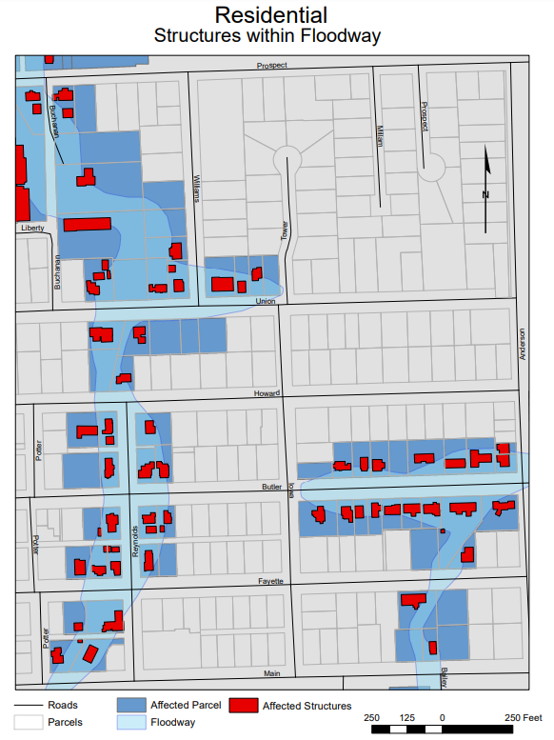
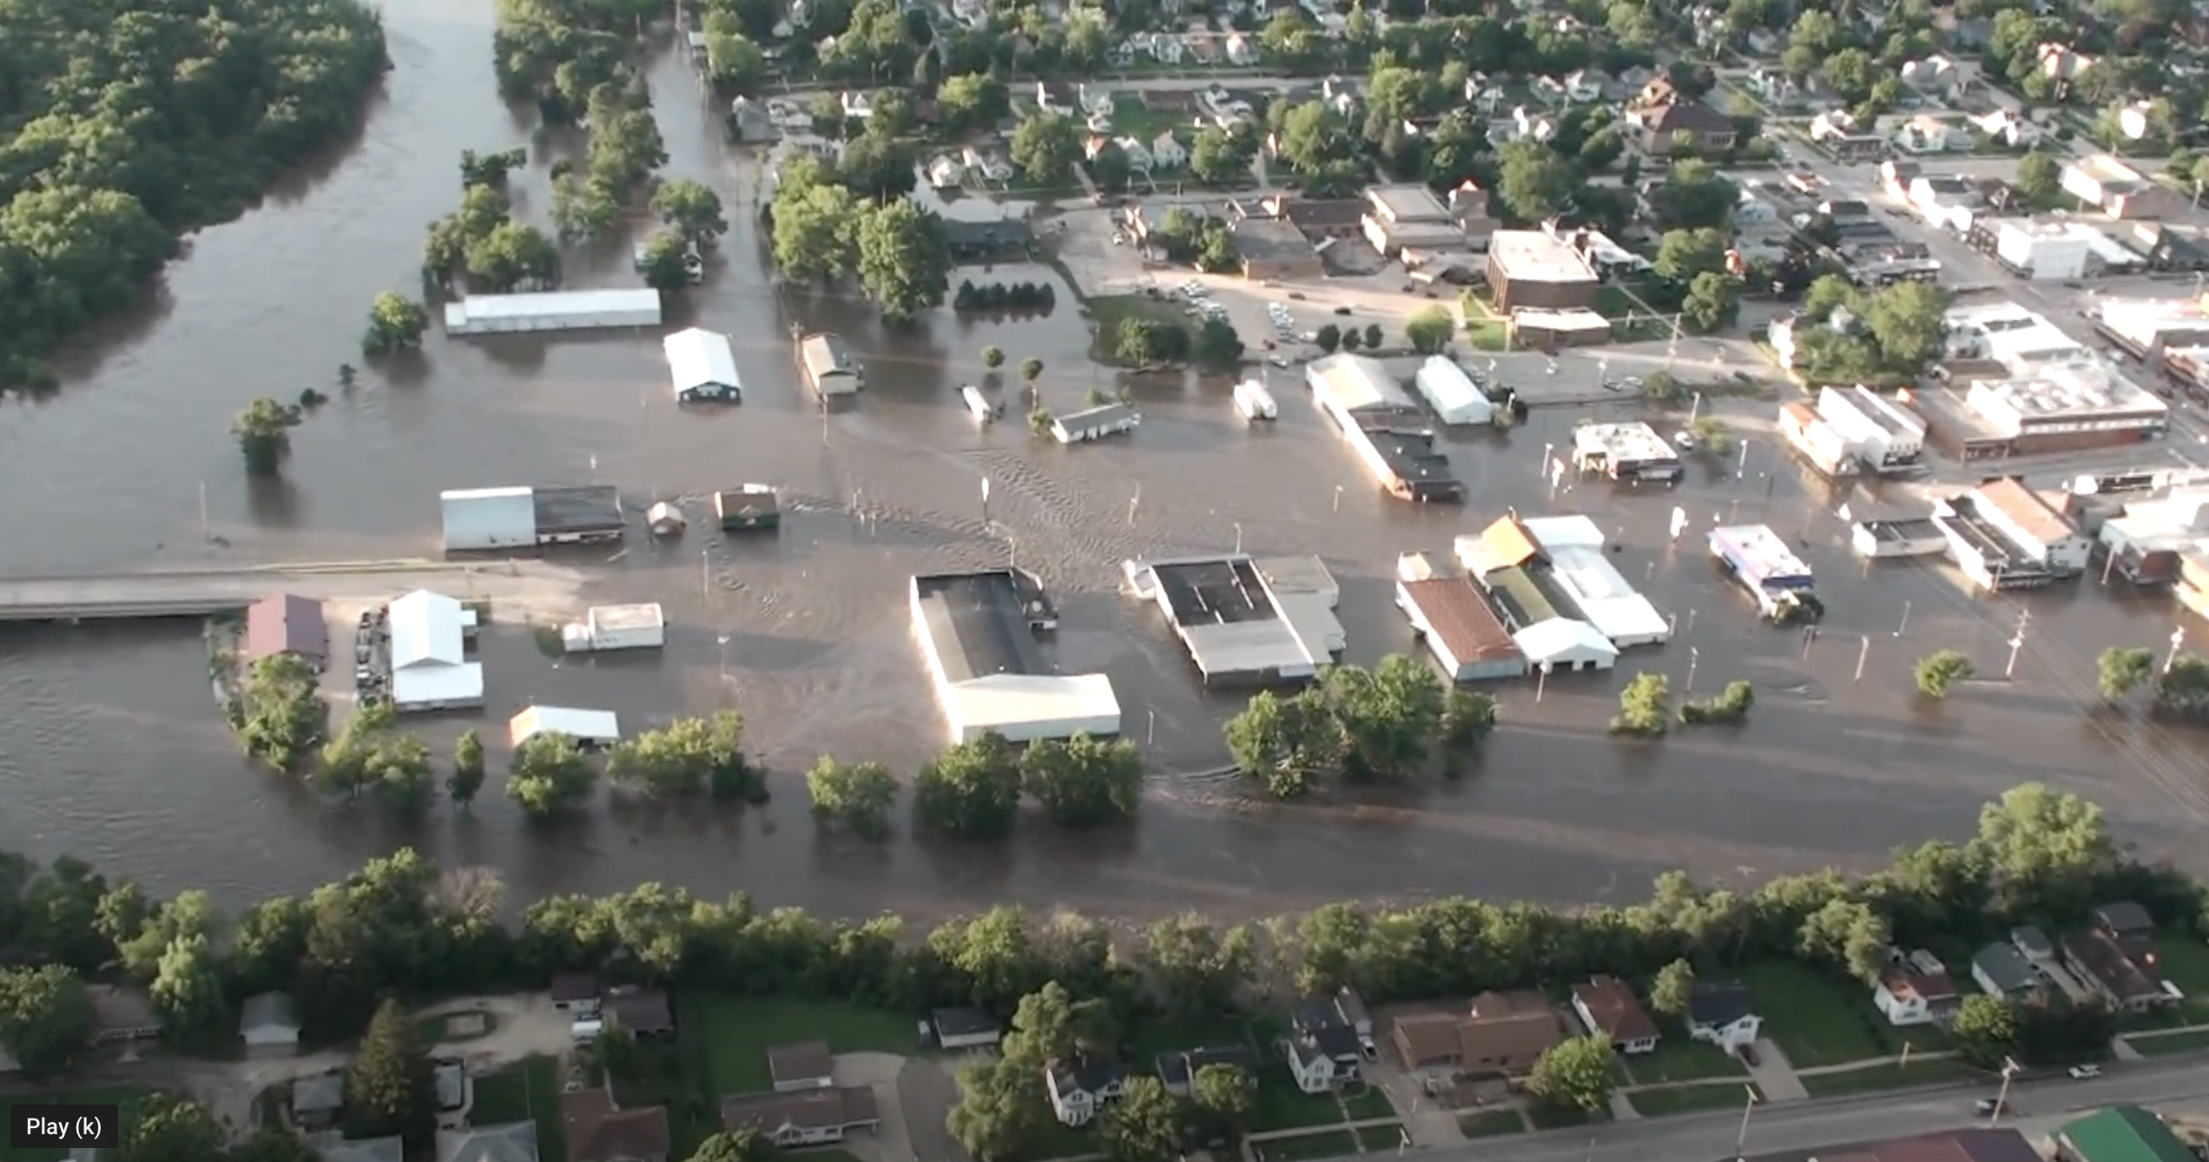
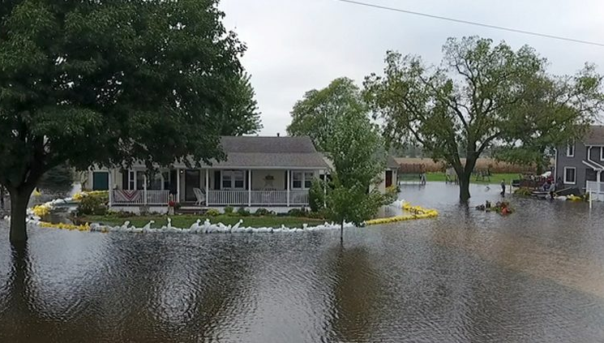
Infill Development
1
2
3
4
5
6
7
8
Structures Located Within The Floodway
Residential Structures Within Floodway
51
Total Housing Demand
(Projected + For Relocation)
466

Slide 19
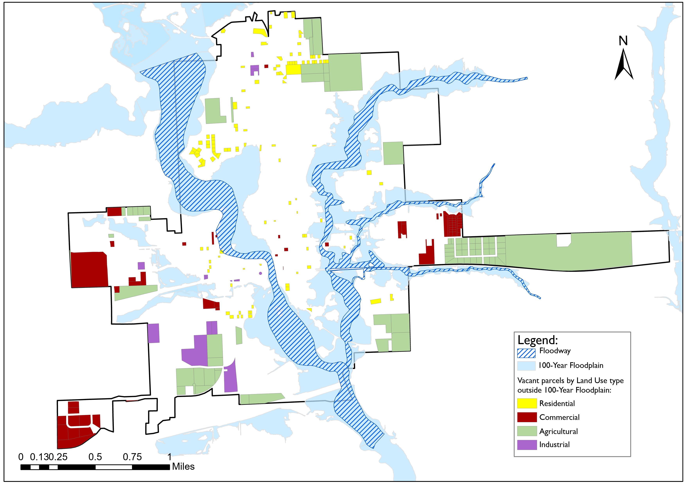
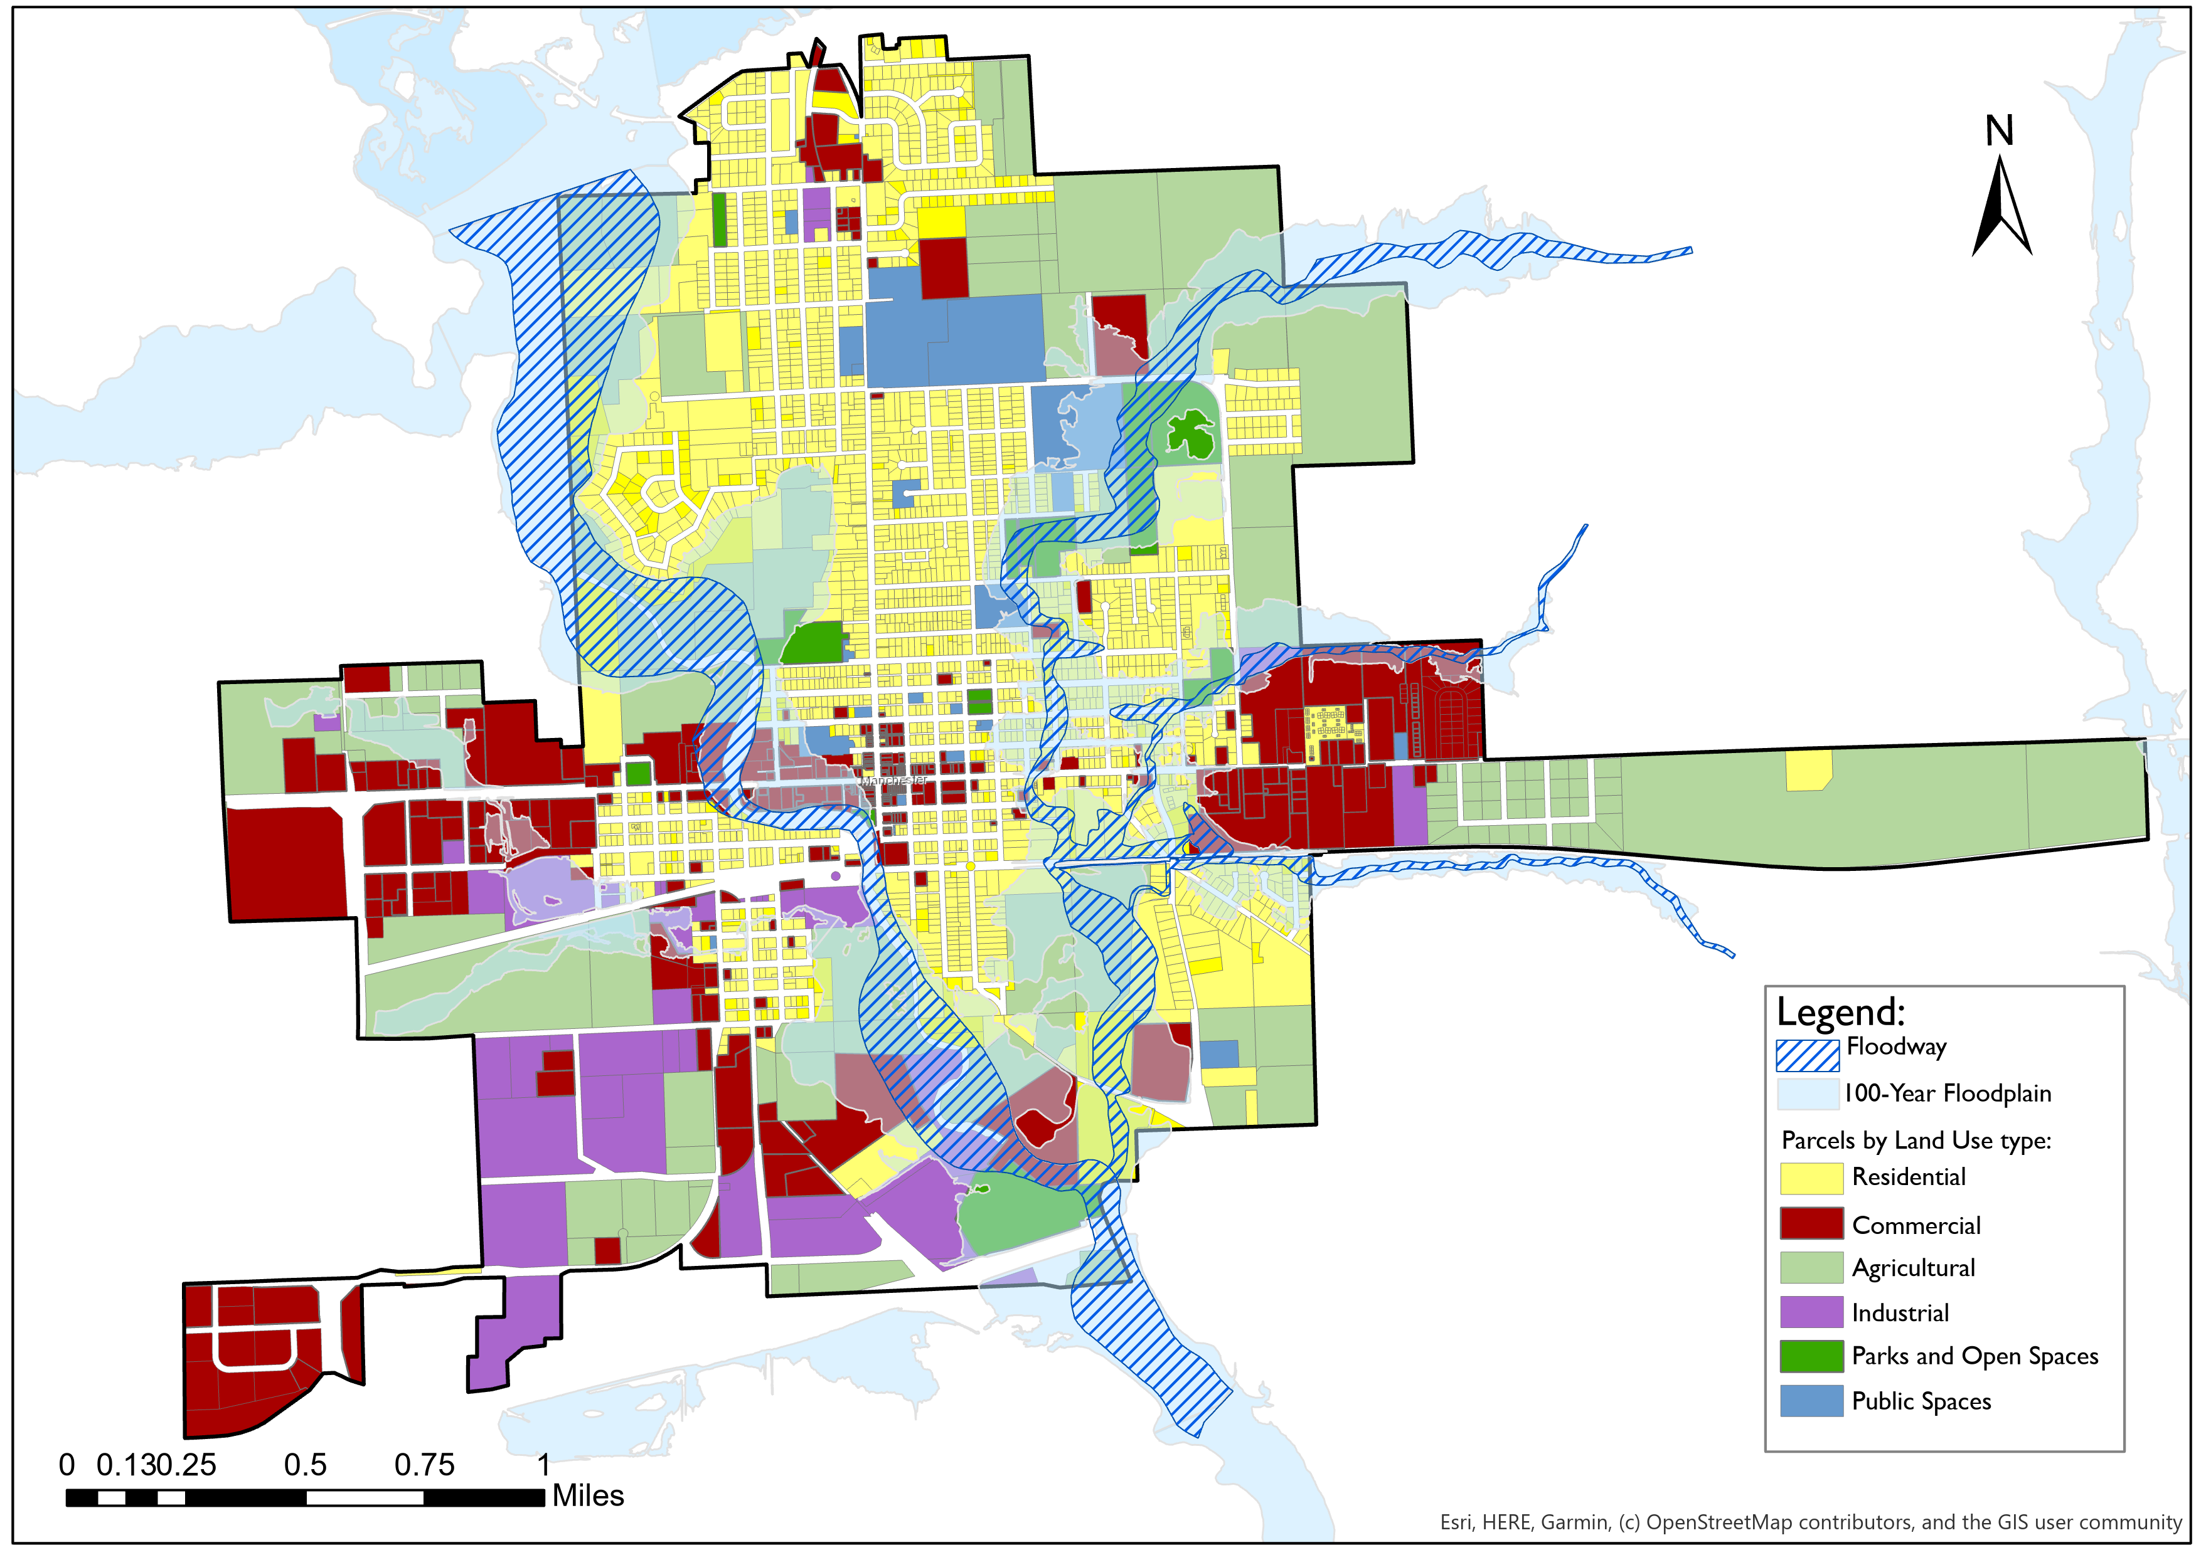
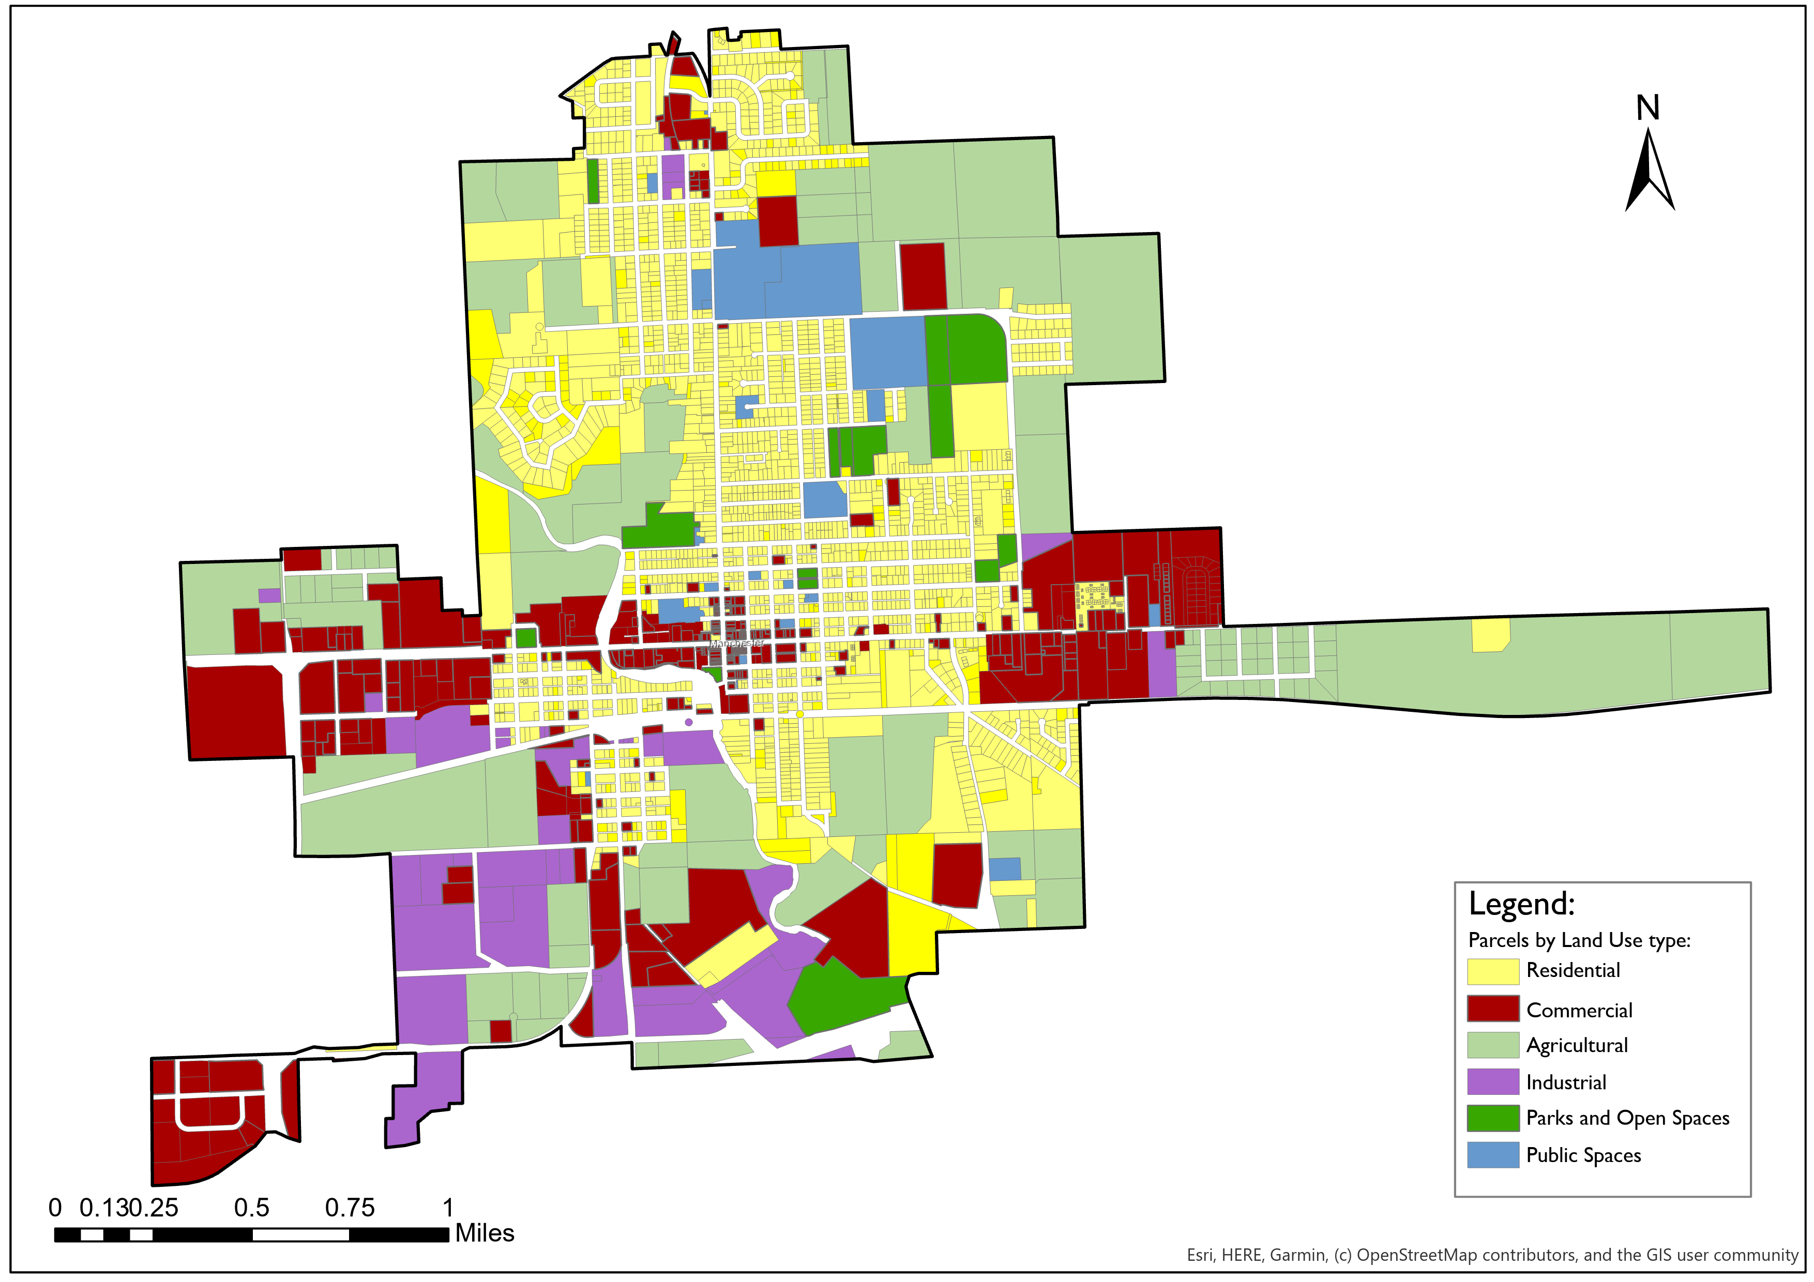
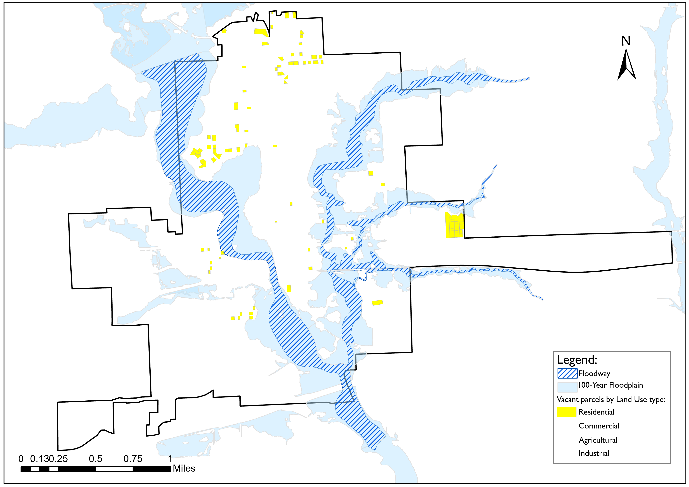
Infill Development
1
2
3
4
5
6
7
8
Suitable Lands For Residential Development
1. Manchester land use map used as a base of analysis
2. Overlay 100-year floodplain on the area of study
3. Removed parcels with built structures
4. Removed parcels completely within Floodplain
5. Filtered residential parcels with development potential
Vacant Residential Parcels
110
Source: Assessors Office, GIS Analysis performed by Authors

Slide 20
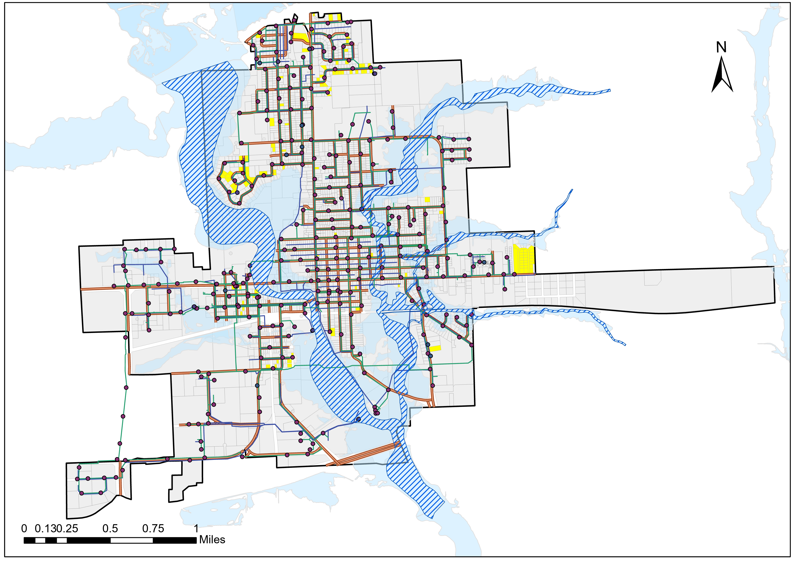
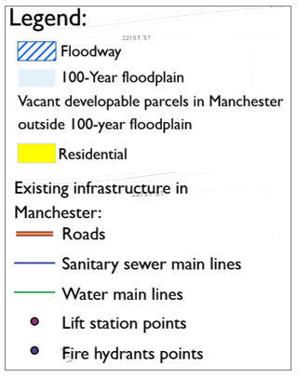
Infill Development
1
2
3
4
5
6
7
8
Housing Shortage
Total Housing Units According To General Plan Density Range
Vacant Residential Parcels
110
158
Total Housing Demand
(Projected + For Relocation)
Housing Shortage
466
308
Source: City of Manchester vacant lots and existing infrastructure

Slide 21



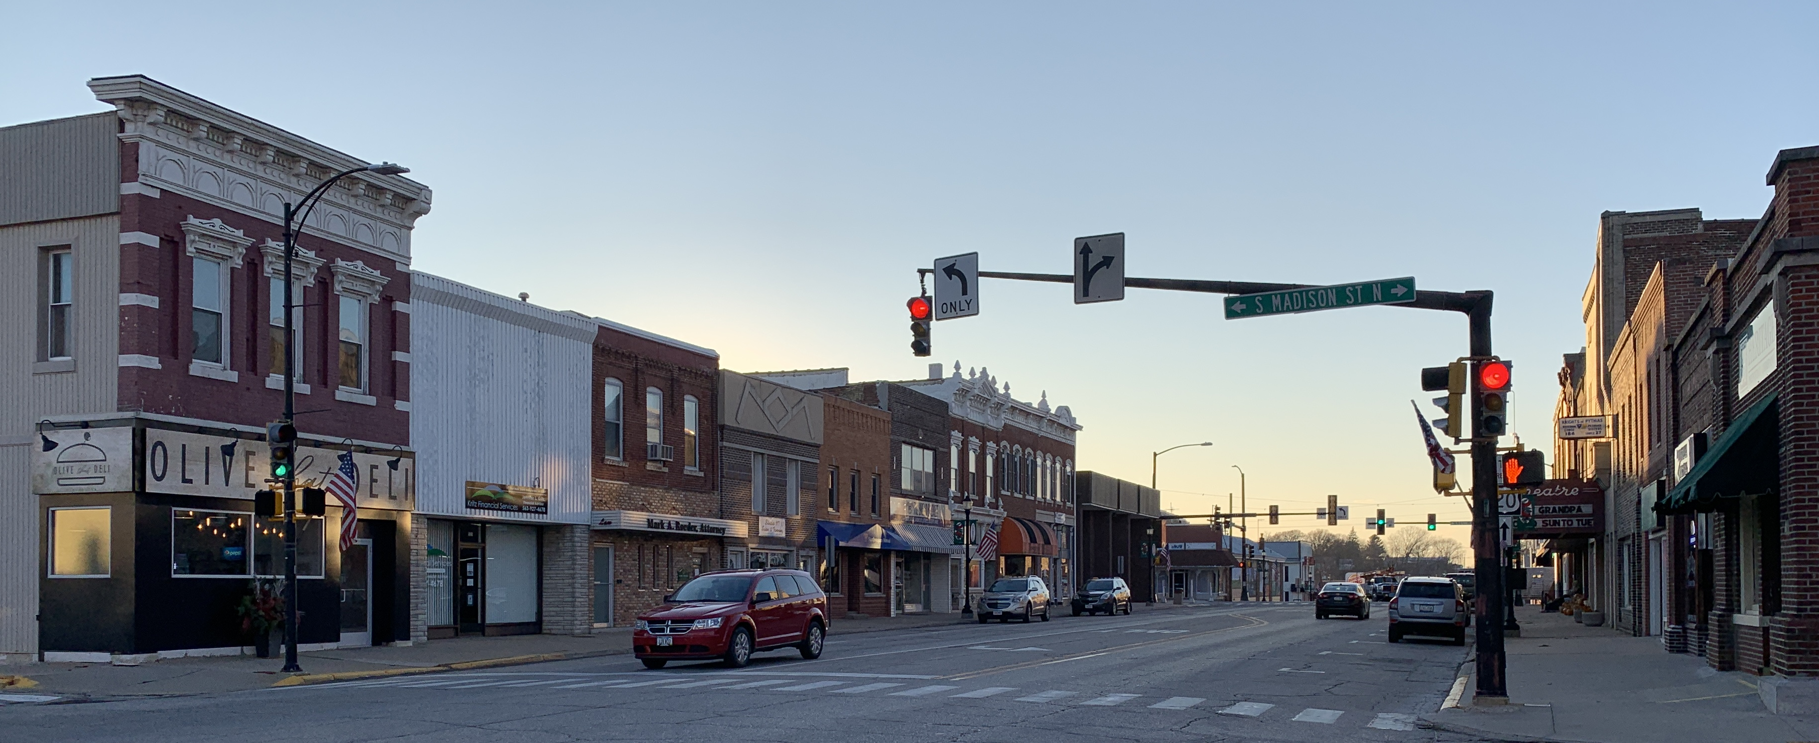
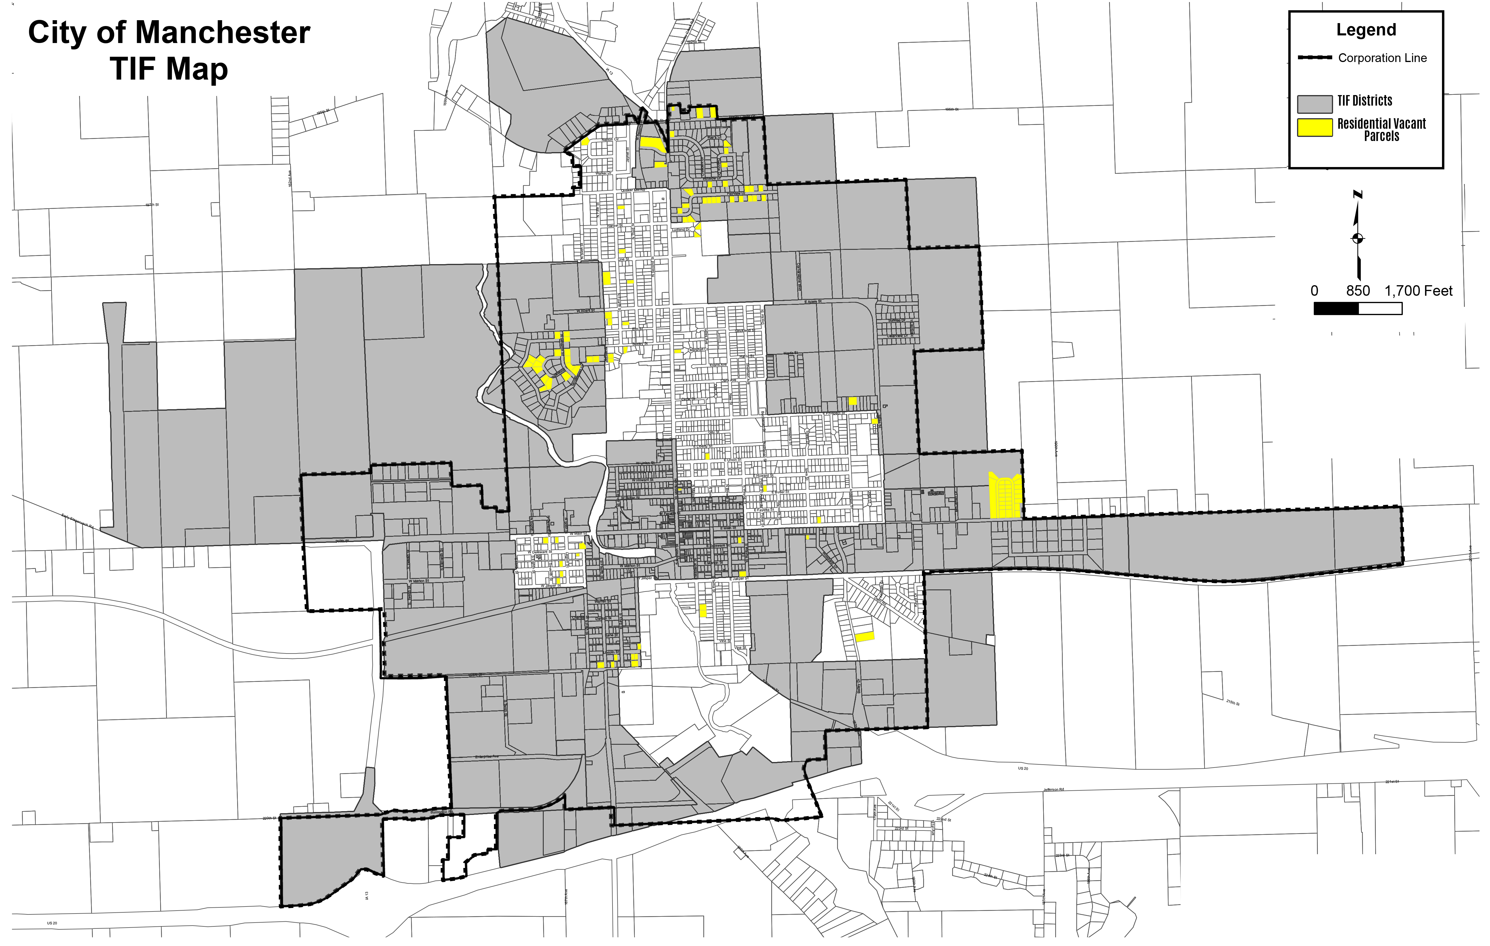
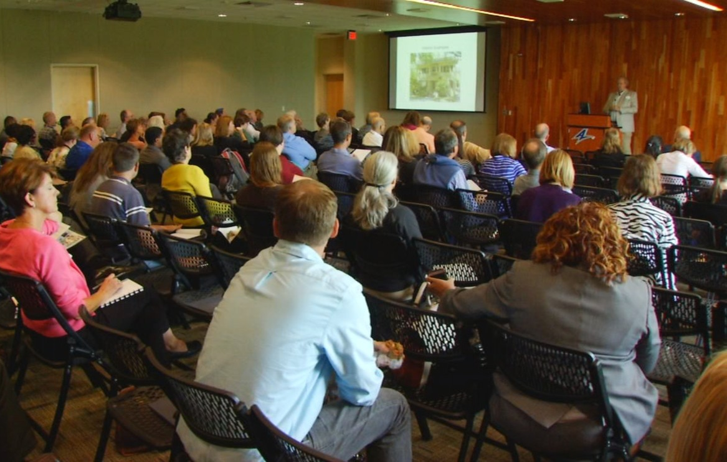
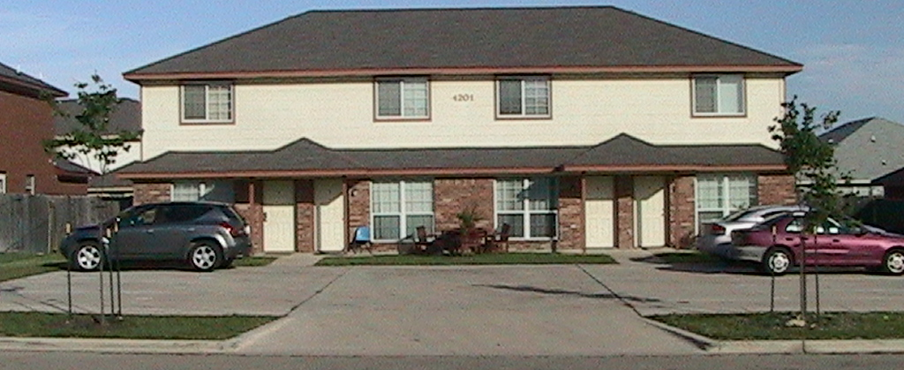
Infill Development
RECOMMENDATIONS
Zoning Considerations
Financial Assistance for Developers
Outreach Efforts
Min. Lot Size Reduction; Density Bonus, By Right Uses, Rezoning
Tax Increment Financing
Housing Summit for Developers
Central Business District
Fourplex Example
Notes:
CSR MAP
METHODOLOGY (WE CREATED IT)
WHAT IS THIS SHOWING
HOW WE WILL USE IN THE FUTURE

Slide 22
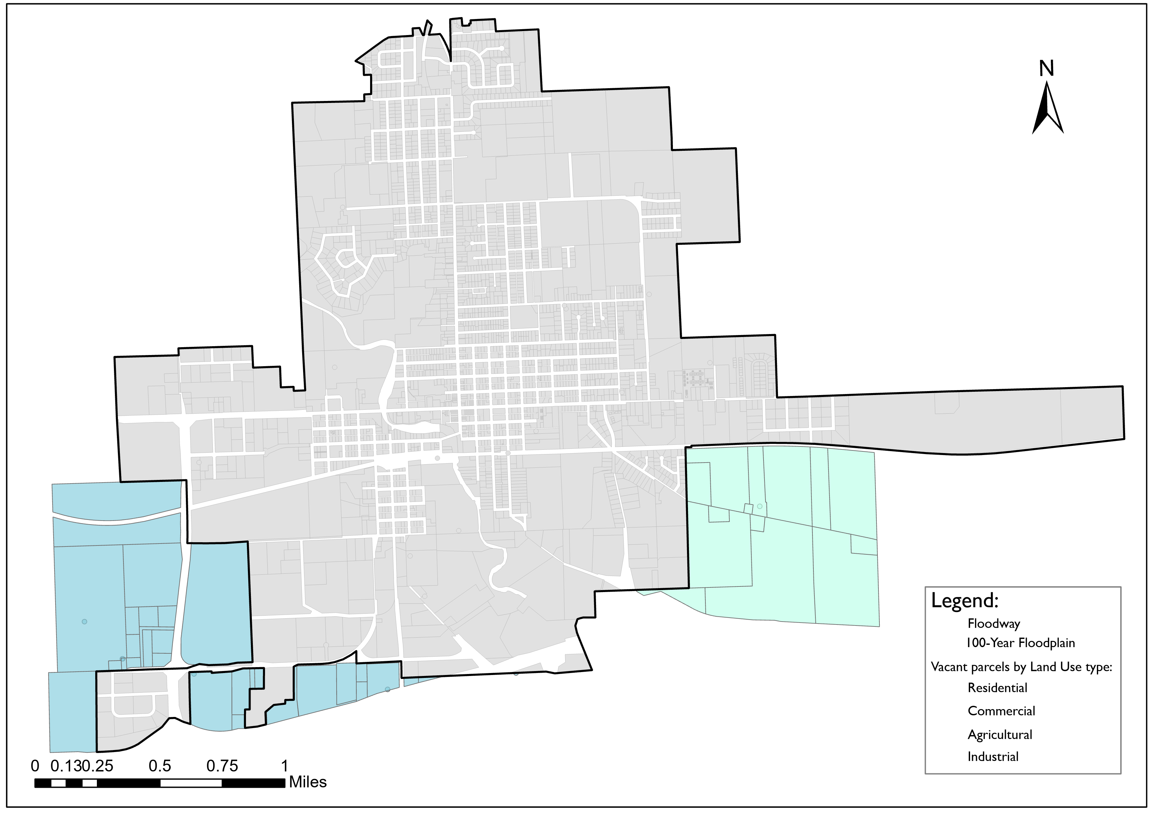

Annexation
1
2
3
4
5
6
7
8
PURPOSE
Help the City make informed decisions about future annexations
Economic feasibility of 2 annexation areas
Notes:
This section will help the city make an informed decision about future annexations looking at possible costs and revenue, as well as determining the economic feasibility of annexing two areas to the city.

Slide 23
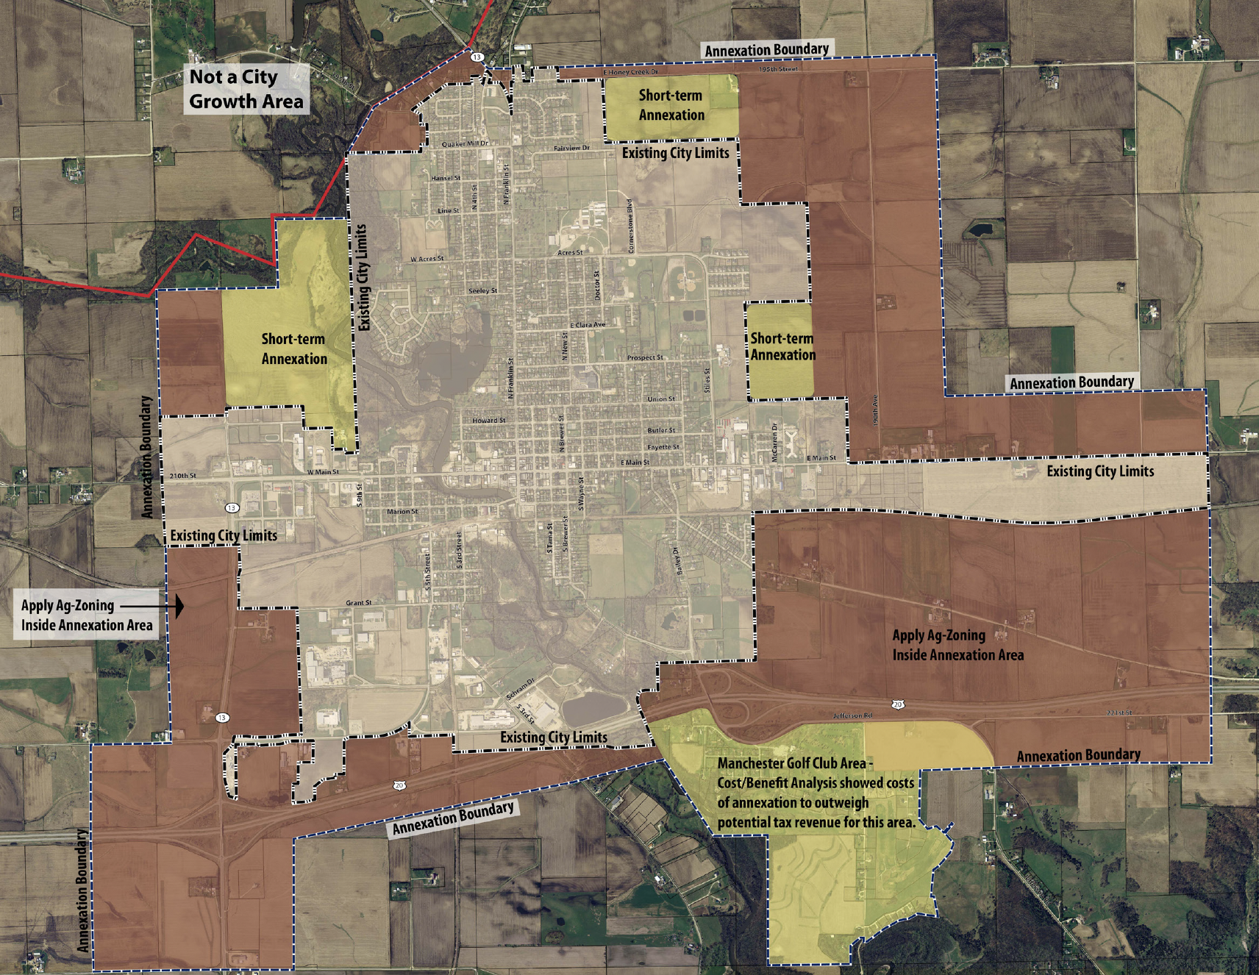
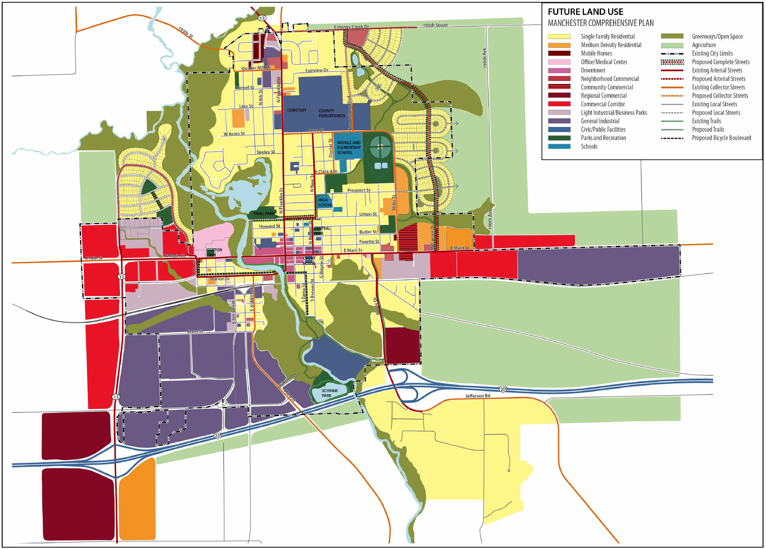
Annexation
1
2
3
4
5
6
7
8
Source: City of Manchester Comprehensive Plan 2012
Manchester’s Comprehensive Plan identifies areas of annexation for the future growth of the city, and the respective Land Uses.

Slide 24
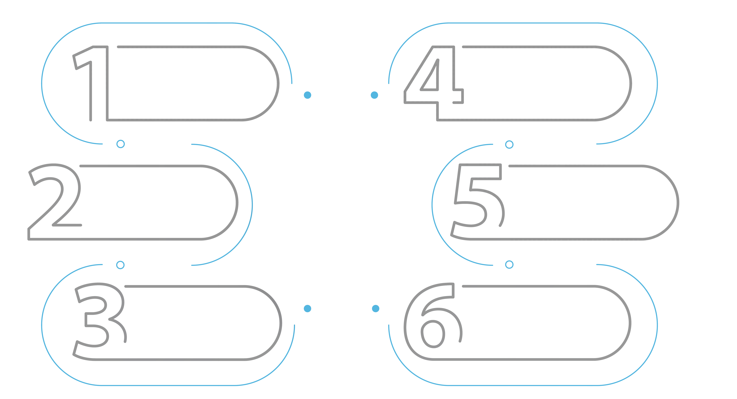

Annexation
1
2
3
4
5
6
7
8
Steps for Fiscal Impact Analysis
Define the annexation area’s boundary and prepare maps of the study area
Determine the revenue of the annexation
Determine the types and acreage of the land parcels within the areas of annexation
Calculate the net present value of annexation
Determine the costs of the annexation
Determine the potential benefits and costs of the annexation

Slide 25
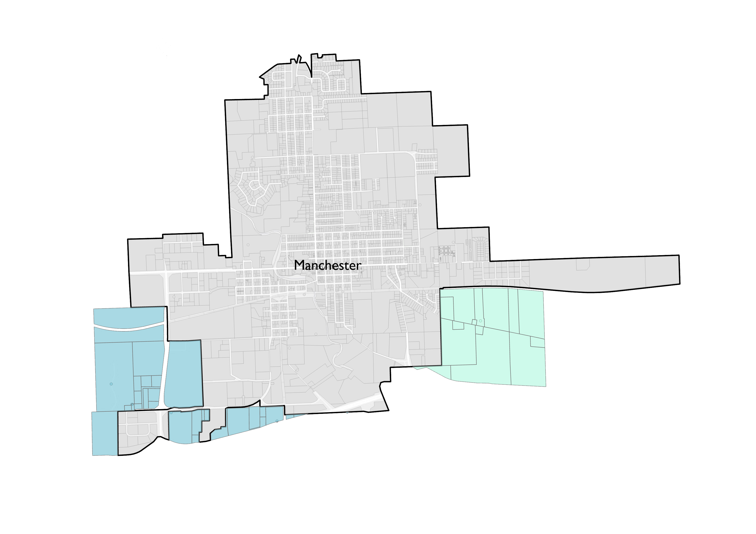
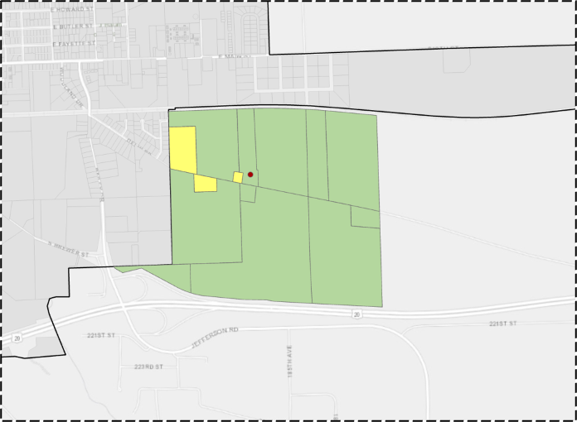
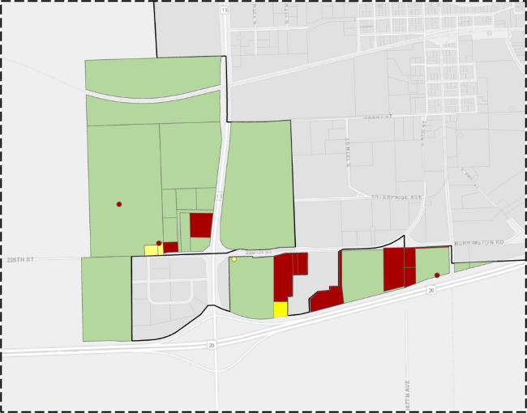
Annexation
1
2
3
4
5
6
7
8
Identified Annexation Areas
Source: Authors
Southeast Growth Area
Southwest Growth Area
Notes:
Identifying the area's boundary is the first step to collect data on revenue and expenditures.
The boundary of each area begins at a point where the proposed boundary line touches the existing city limits line and continues around the proposed annexation area by general cardinal directions.

Slide 26
Annexation
1
2
3
4
5
6
7
8
Net Present Value
Southwest Annexation Area
With Provision of Tax Exemption in 10 Years
Total Net Present Value = - $289,333.59
Without Provision of Tax Exemption in 10 Years
Total Net Present Value = $76,507.76
Notes:
To calculate the costs and revenue of annexing one area, this is important to know the unit of analysis. Since annexation is the acquisition of land, this model assumes per acre units are the most suitable unit for analysis. The model also considers that the costs of city service vary for different types of land uses as their revenue is different. Thus, the methodology for calculating the costs and revenue of the annexation is based on the type of land use.
In the model, combined are all types of similar land uses to give six land use categories including, residential, commercial, industrial, open spaces, public spaces, and streets.
For prospective areas of annexation, the type and acreage of the land parcels need to be determined. The land use type should fall in one of the land use categories represented in Figure 6-6. By having the acreage of all land types in the area, the model calculates the total cost of providing public services.
The methodology for calculating the costs and revenue of the annexation is based on the type of land use.
For prospective areas of annexation, the type and acreage of the land parcels need to be determined. The land use type should fall in one of the land use categories here represented. By having the acreage of all land types in the area, the model calculates the total cost of providing public services.
Total costs include both capital and operational expenditures. To calculate the cost of annexing one area, the first thing to do is to calculate the unit of cost for services that the City provides. This plan calculated the per acreage cost of the city services for each of the land use categories and represent them in table **** to ****.
Below is a summary of the steps that should be taken for calculating the cost of services that the city of Manchester provides. It is important to notice that all the costs for city services are based on the Fiscal Year 2020-2021 Budget and they might be different in the future.
1. Choose a particular service.
2. Allocate to each particular zoning category how much of that service is consumed or required.
3. Divide total expenditure for that service according to the proportions of use taken up by a particular zoning use.
4. Divide that proportional cost of total expenditure by the number of acres in that zoning use to get a per acre cost.
5. Multiply per acre cost for a particular service by the acreage of land for all categories of land in the area to calculate the cost for each of those categories. Then, sum all those costs to calculate the total cost for that service.
NOT COMPLETE BECAUSE WE ARE WAITING FOR CITY DATA

Slide 27
Annexation
1
2
3
4
5
6
7
8
Net Present Value
Southeast Annexation Area
With Provision of Tax Exemption in 10 Years
Total Net Present Value = - $320,594.31
Without Provision of Tax Exemption in 10 Years
Total Net Present Value = - $257,248.72
Notes:
To calculate the costs and revenue of annexing one area, this is important to know the unit of analysis. Since annexation is the acquisition of land, this model assumes per acre units are the most suitable unit for analysis. The model also considers that the costs of city service vary for different types of land uses as their revenue is different. Thus, the methodology for calculating the costs and revenue of the annexation is based on the type of land use.
In the model, combined are all types of similar land uses to give six land use categories including, residential, commercial, industrial, open spaces, public spaces, and streets.
For prospective areas of annexation, the type and acreage of the land parcels need to be determined. The land use type should fall in one of the land use categories represented in Figure 6-6. By having the acreage of all land types in the area, the model calculates the total cost of providing public services.
The methodology for calculating the costs and revenue of the annexation is based on the type of land use.
For prospective areas of annexation, the type and acreage of the land parcels need to be determined. The land use type should fall in one of the land use categories here represented. By having the acreage of all land types in the area, the model calculates the total cost of providing public services.
Total costs include both capital and operational expenditures. To calculate the cost of annexing one area, the first thing to do is to calculate the unit of cost for services that the City provides. This plan calculated the per acreage cost of the city services for each of the land use categories and represent them in table **** to ****.
Below is a summary of the steps that should be taken for calculating the cost of services that the city of Manchester provides. It is important to notice that all the costs for city services are based on the Fiscal Year 2020-2021 Budget and they might be different in the future.
1. Choose a particular service.
2. Allocate to each particular zoning category how much of that service is consumed or required.
3. Divide total expenditure for that service according to the proportions of use taken up by a particular zoning use.
4. Divide that proportional cost of total expenditure by the number of acres in that zoning use to get a per acre cost.
5. Multiply per acre cost for a particular service by the acreage of land for all categories of land in the area to calculate the cost for each of those categories. Then, sum all those costs to calculate the total cost for that service.
NOT COMPLETE BECAUSE WE ARE WAITING FOR CITY DATA

Slide 28


Annexation
Findings and Recommendations
Manchester should prioritize annexation of the Southwest Growth Area
Annexation of the Southeast Area is not economically beneficial to the city
(considering current land use and Future Land Use Map)
Therefore, if the city decides to annex the Southeast Growth area to accommodate the future needs of the community, this plan recommends revisiting the future land use of the Southeast Growth Area.

Slide 29

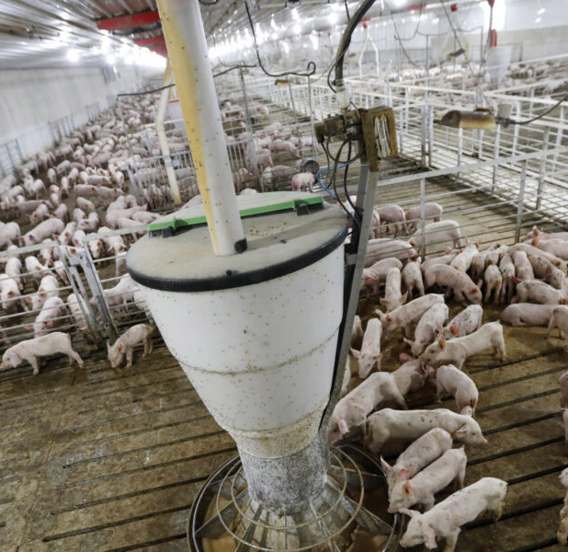
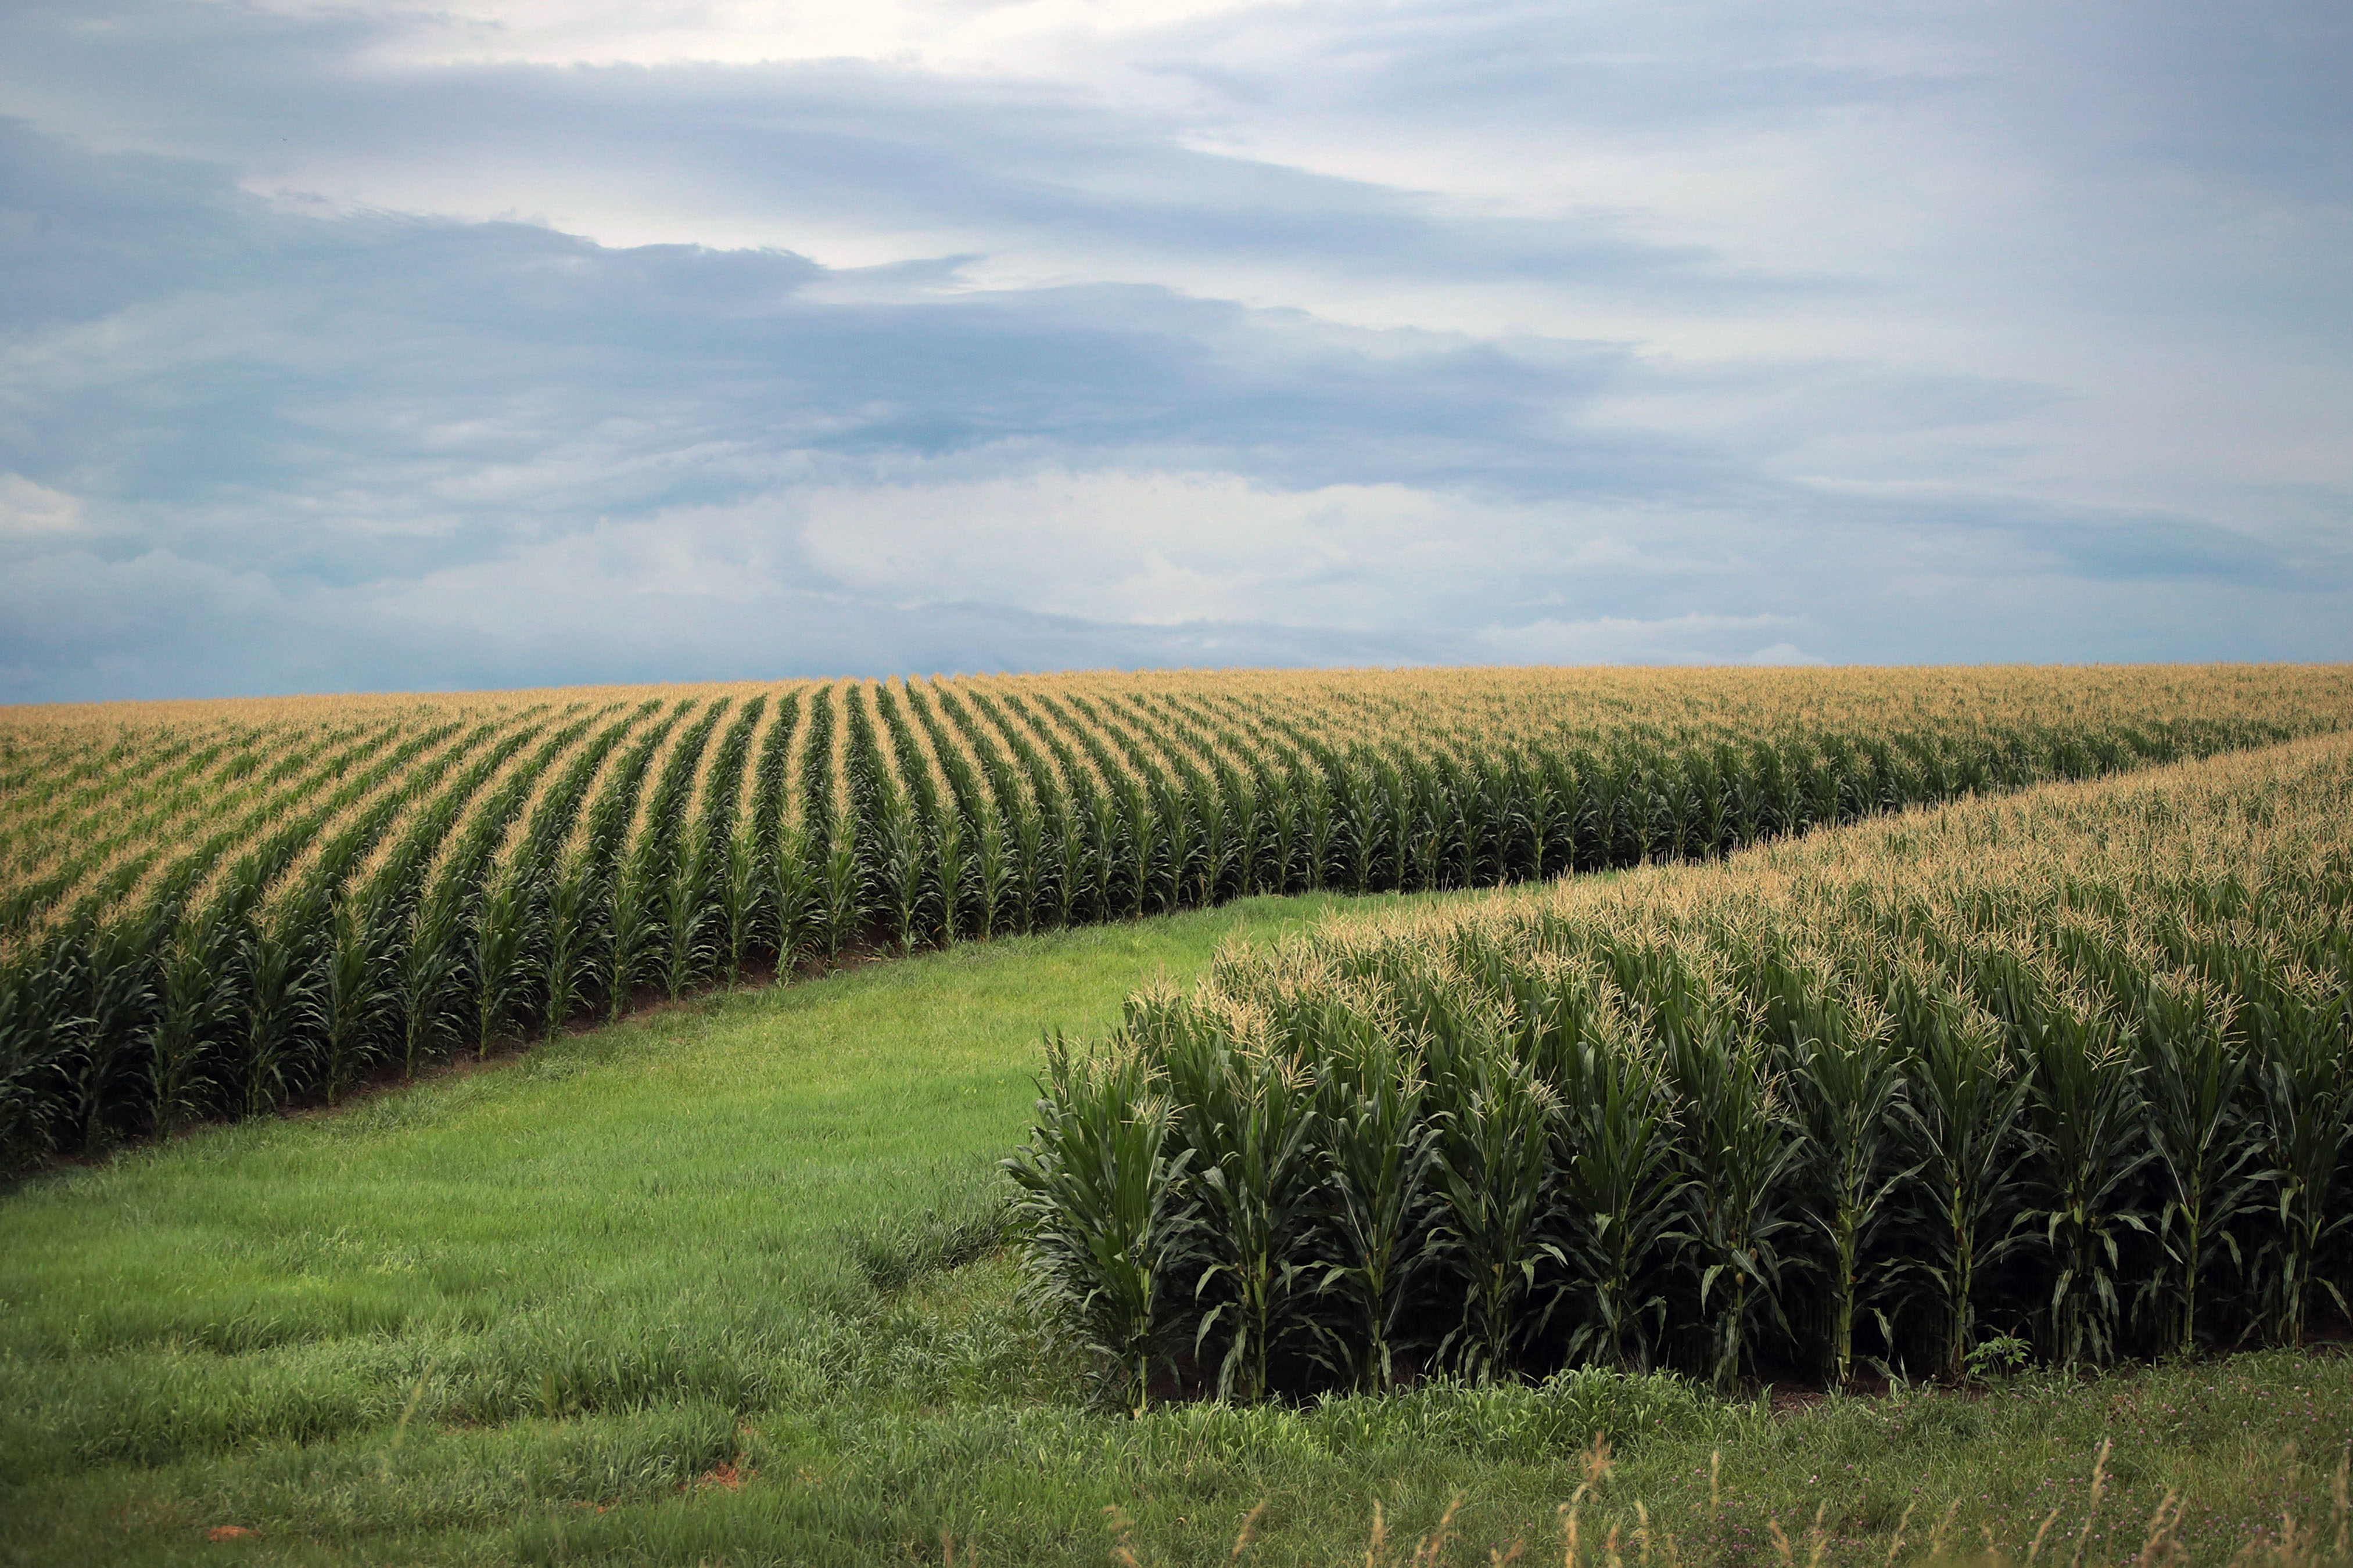


EXTRATERRITORIAL ZONING
1
2
3
4
5
6
7
8
PURPOSE
Importance of the application of Extraterritorial Zoning Map
Create a preliminary extraterritorial zoning map
Guide the implementation of Extraterritorial Zoning
Can help prevent unsuitable and disorganized development around Manchester (i.e. CAFOs, sprawl)
Can help preserve prime agricultural land and sensitive areas
Guide the City on the process of informing property owners

Slide 30
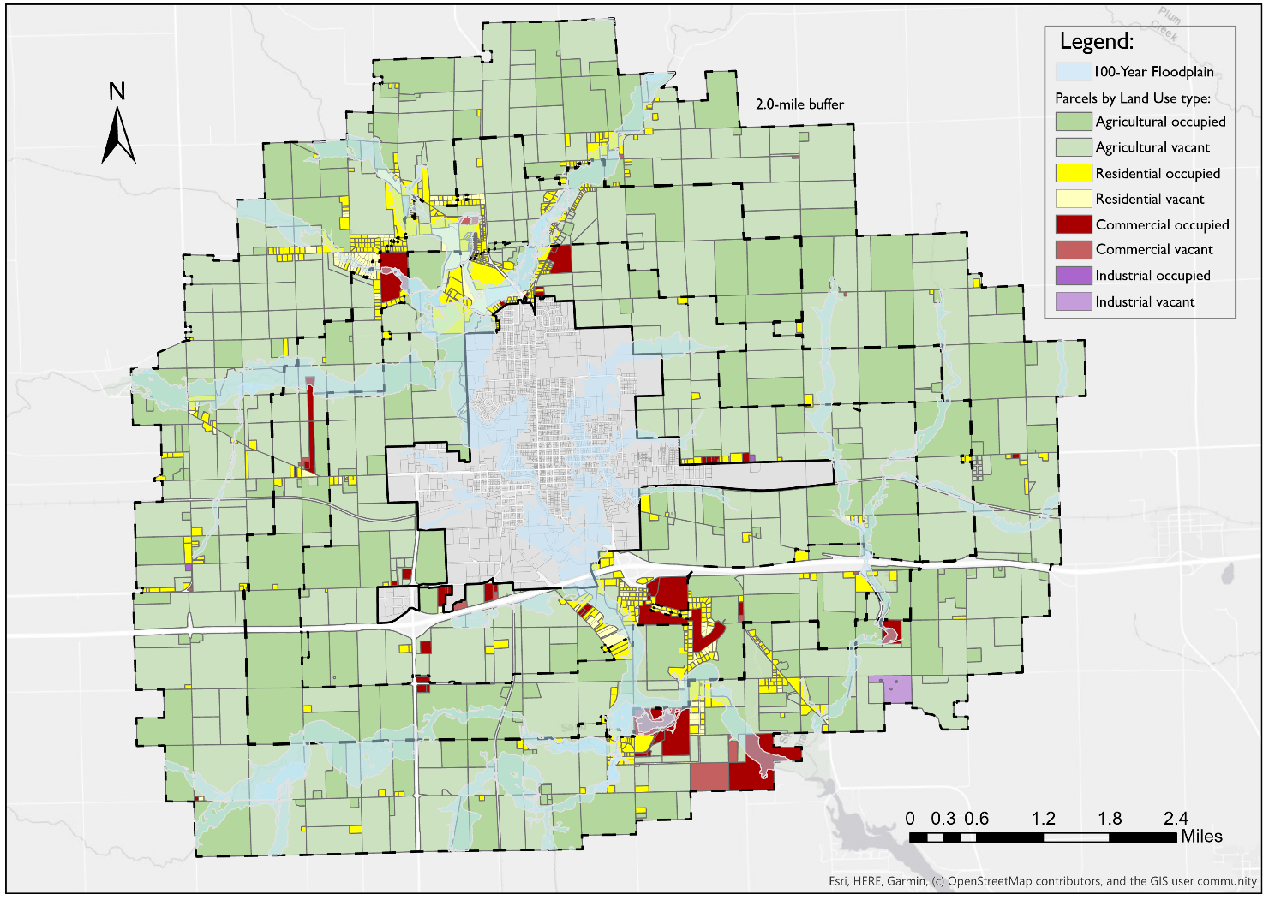



EXTRATERRITORIAL ZONING
1
2
3
4
5
6
7
8
Development Trend in Two-mile Buffer
75%
52%
66%
31%
Notes:
This section will help the city make an informed decision about future annexations looking at possible costs and revenue, as well as determining the economic feasibility of annexing two areas to the city.

Slide 31
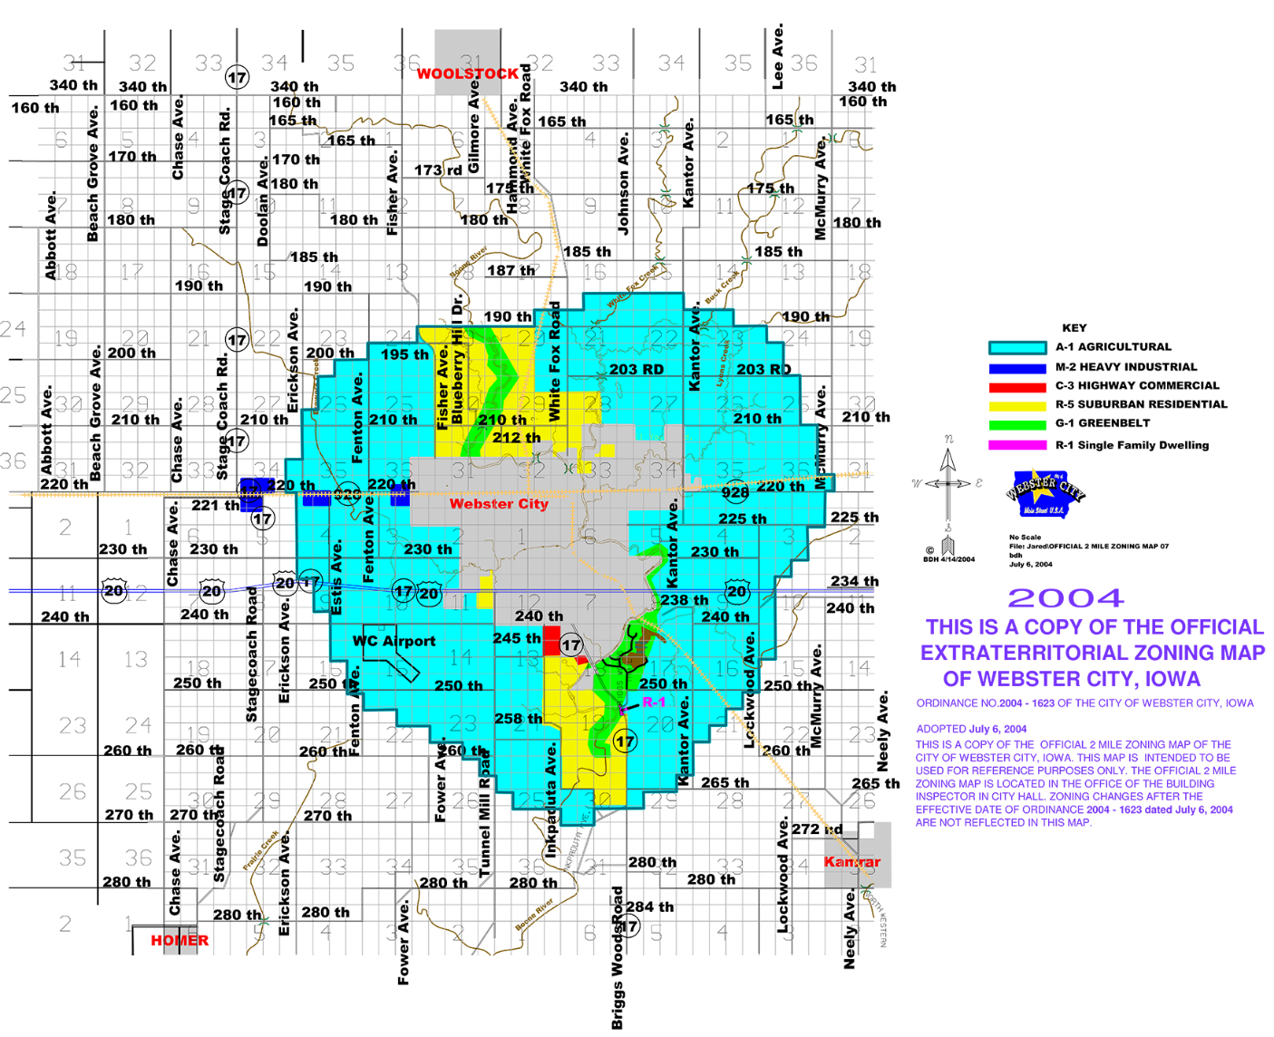
EXTRATERRITORIAL ZONING
1
2
3
4
5
6
7
8
Strategies and Recommendations from Peer Communities
City of Dysart
Ordinance gives authority to regulate agricultural activities in or on the floodplains of any river or stream
Webster City
A “greenbelt” was implemented to accommodate green space and flood water
Commercial feedlots, grain storage, and drying facilities are not allowed within the “greenbelts”
Notes:
This section will help the city make an informed decision about future annexations looking at possible costs and revenue, as well as determining the economic feasibility of annexing two areas to the city.

Slide 32
EXTRATERRITORIAL ZONING
Recommendations
1
2
Establish Extraterritorial Zoning Powers To Guide And Regulate Growth On The Periphery Of The City
Research The Feasibility Of The Adoption Of A Greenbelt District
Notes:
This section will help the city make an informed decision about future annexations looking at possible costs and revenue, as well as determining the economic feasibility of annexing two areas to the city.

Slide 33
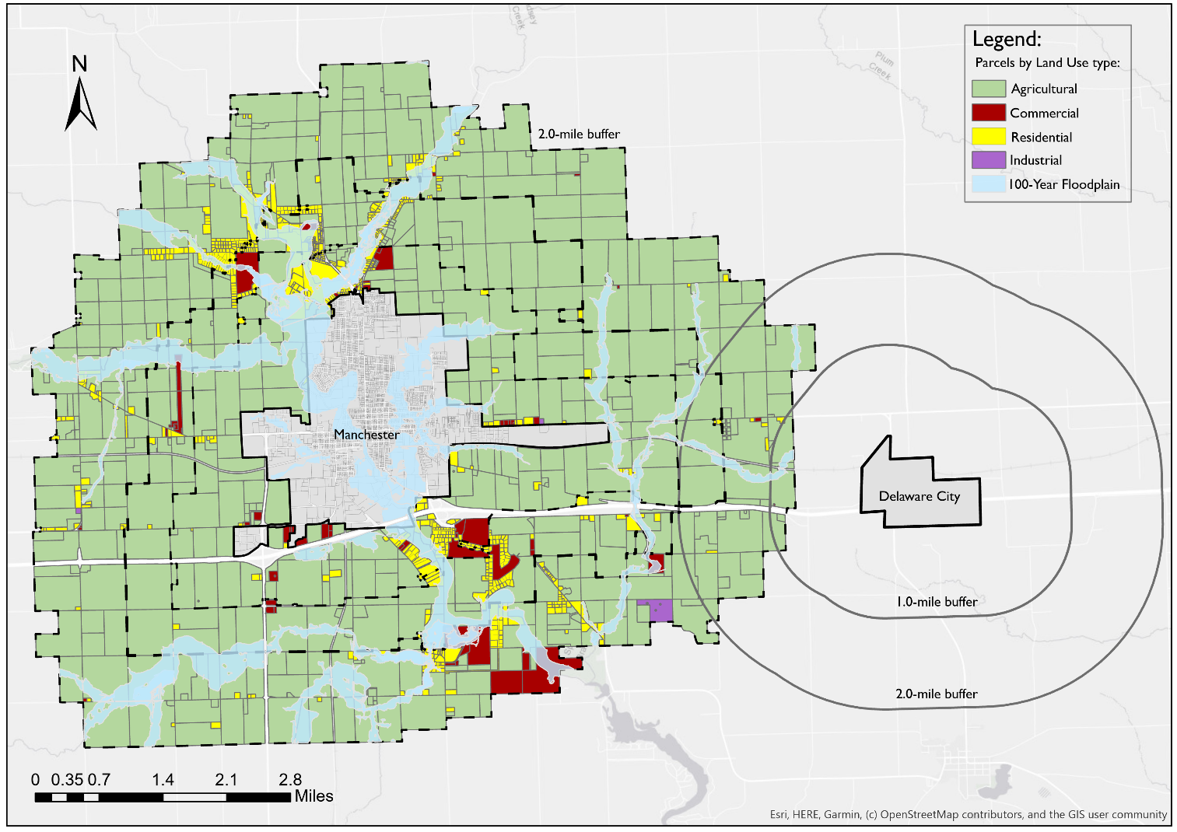




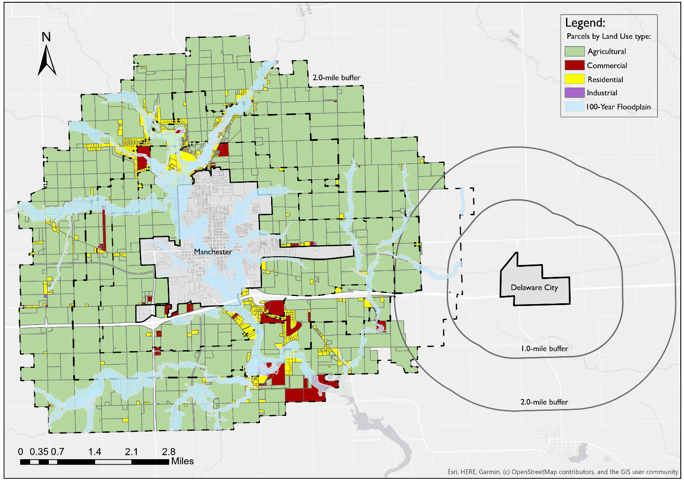


EXTRATERRITORIAL ZONING
1
2
3
4
5
6
7
8
Guiding the Implementation of Extraterritorial Zoning
1. Confer with the County
2. Appoint New Board and Commission Members
3. Limits with Neighboring Cities for Extraterritorial Zoning
4. Draft an Ordinance for the Extraterritorial Zone and Update Maps
5. Give Notice to Affected Property Owners
6. City Council Holds a Public Hearing and Passes the Ordinance
Notes:
This section will help the city make an informed decision about future annexations looking at possible costs and revenue, as well as determining the economic feasibility of annexing two areas to the city.

Slide 34
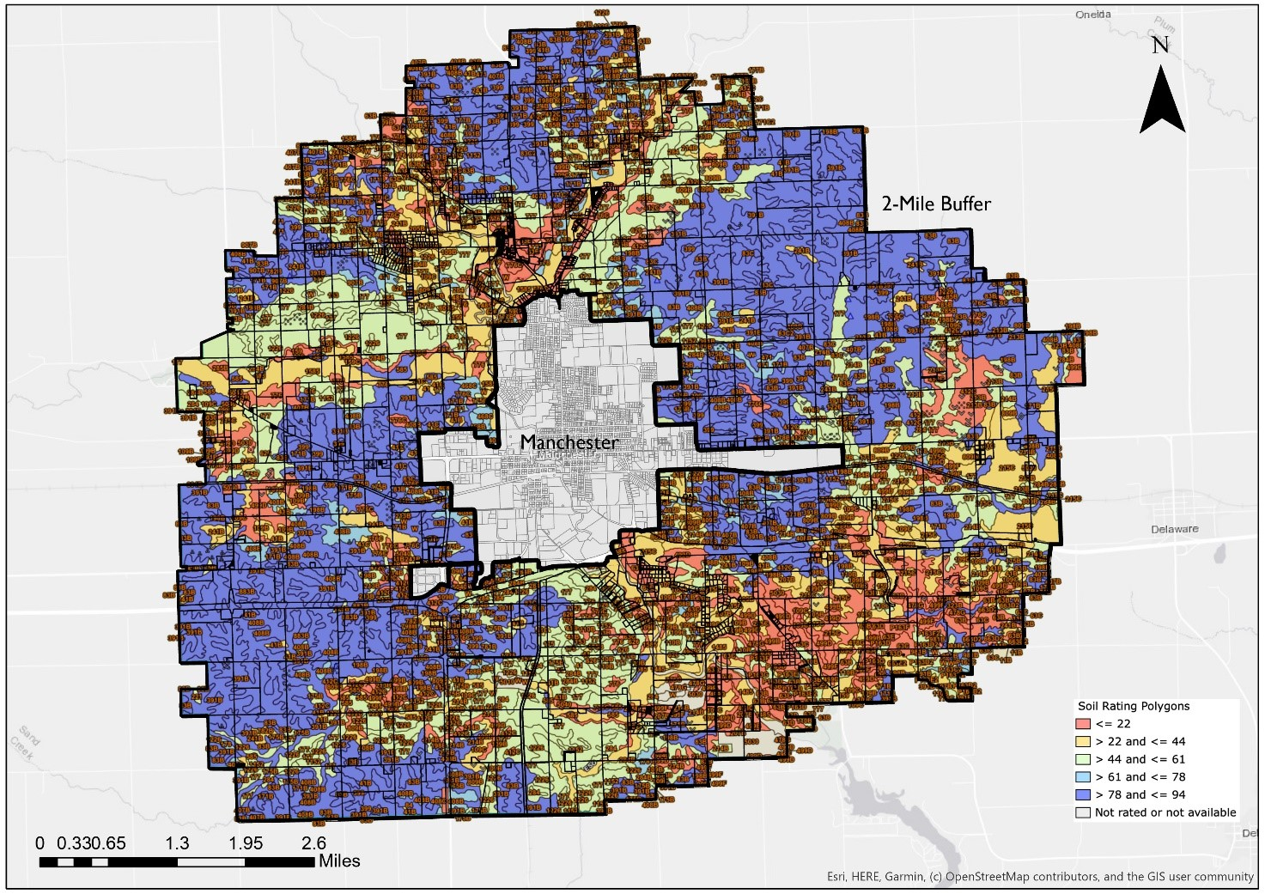
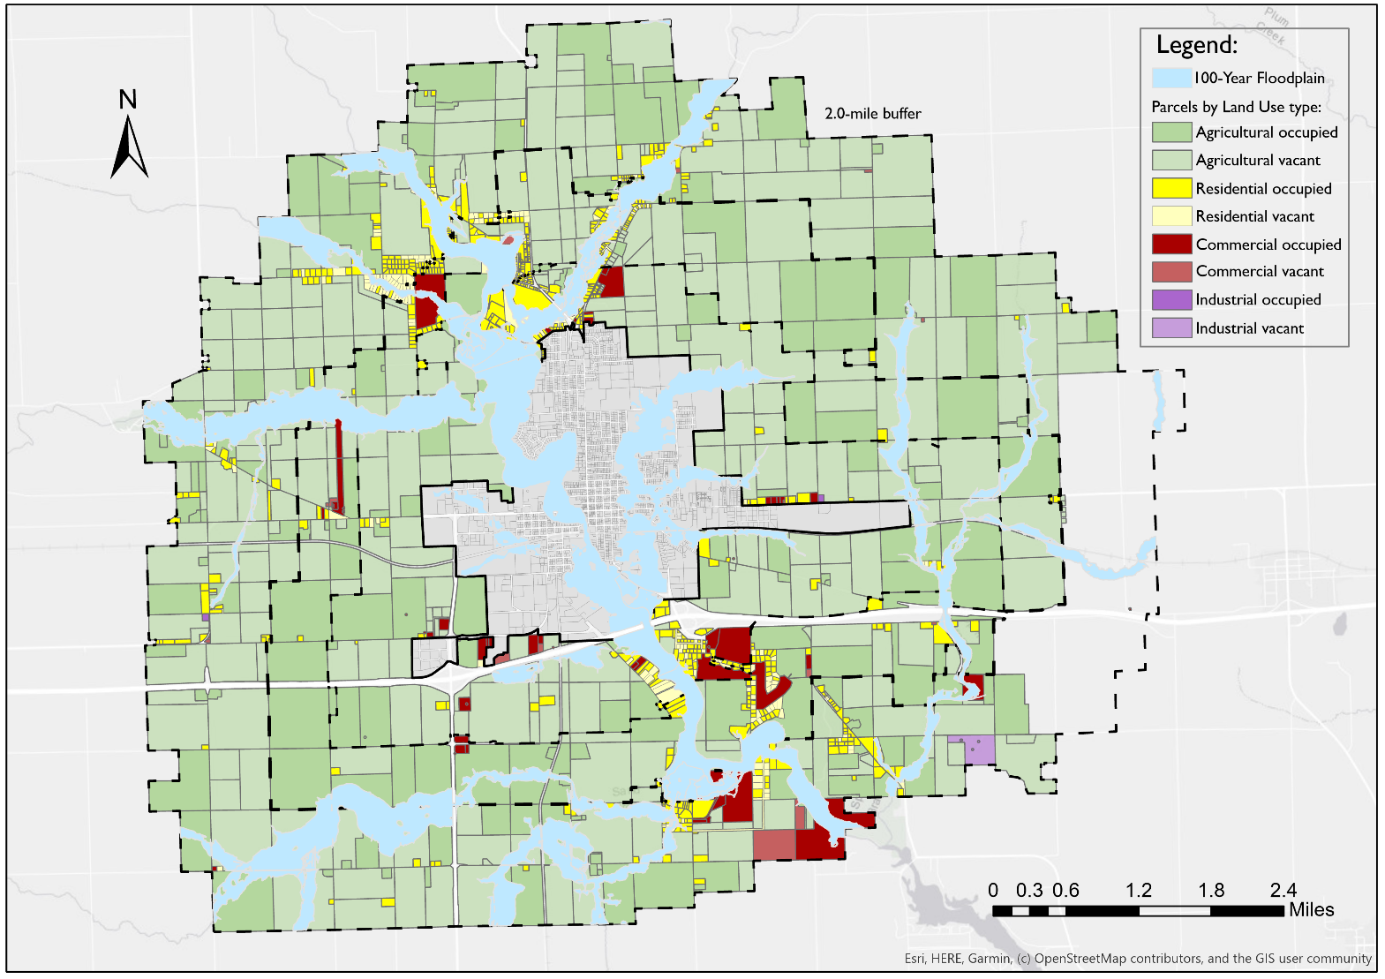


EXTRATERRITORIAL ZONING
1
2
3
4
5
6
7
8
Identification of Areas for Preservation from Development
Lands with High Corn Suitability Rating to identify preservable prime farmland/agricultural lands
100-year Floodplain to prevent developments on floodway and floodplain and mitigate flood hazards
Notes:
This section will help the city make an informed decision about future annexations looking at possible costs and revenue, as well as determining the economic feasibility of annexing two areas to the city.

Slide 35
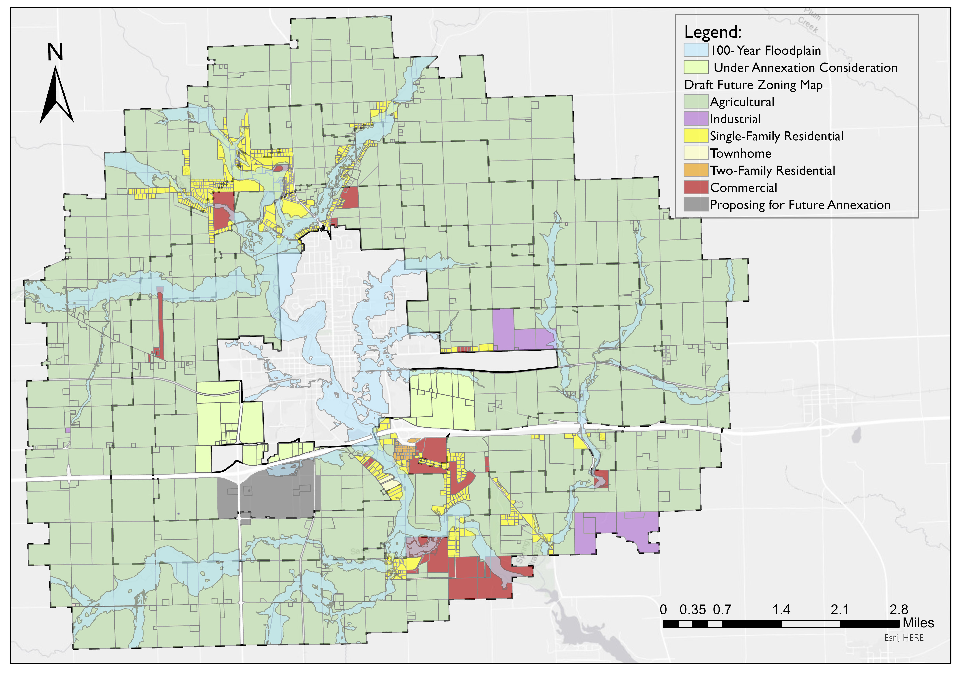


EXTRATERRITORIAL ZONING
1
2
3
4
5
6
7
8
Developing the Future Zoning Map
Proximity to the 100-year floodplain
Corn Suitability Rating
Proximity to fractured zones
Proximity to Manchester’s city limits where there are more services
Notes:
This section will help the city make an informed decision about future annexations looking at possible costs and revenue, as well as determining the economic feasibility of annexing two areas to the city.

Slide 36

THANK YOU

Slide 37
Appendices

Slide 38












Annexation
Potential Benefits of Annexation to the City
Creates a mechanism that
allows for accommodating
future growth
Allows the city to plan for
providing public services
Can guarantee that the city
gets compensated for the
services it provides
Allows the city to provide
enough residential,
commercial, industrial
opportunities for future
residents
Allows city to be able to
concentrate development in
desirable areas
Prevent urban sprawl by
encouraging development in
urban areas where adequate
public facilities already exist
Can decrease the level of the
underdeveloped area and
prevent development
Can prevent development
on unsuitable lands such as
those lying in a floodplain or
agricultural land with a high
Corn Suitability Rating
Has the potential to improve
the city revenue since it
would increase the tax base
for the community
Prevents incompatible uses
adjacent to the residential
areas within the city

Slide 39



EXTRATERRITORIAL ZONING
Additional Recommendations
Convincing Property Owners In The Two—mile Buffer Area To Make Restrictive Covenants
Fringe Area Agreements with Delaware County
Involuntary Annexation, if Necessary, for Public Purpose
Notes:
This section will help the city make an informed decision about future annexations looking at possible costs and revenue, as well as determining the economic feasibility of annexing two areas to the city.

