Slide 1

Don Williams Park Disc Golf Course

Slide 2
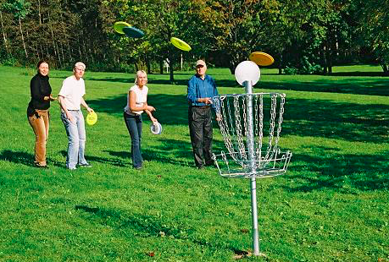
Disc Golf as a Leisure Sport

Slide 3
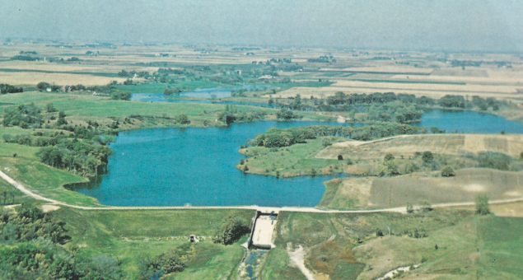
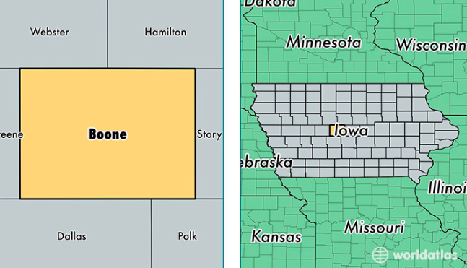
Don Williams Park
Notes:
Explain existing features and attractions

Slide 4
Why Me?
Office of Outreach and Engagement
Facilitate research into the value, feasibility, and implementation of a disc golf course
Notes:
They all have jobs, stuff that requires their daily attention. I started with researching existing knowledge of disc golf. I found 3 main takeaways pertinent to the creation of a course at Don Williams Park: Booming popularity of the sport, a potential source of revenue and tourism dollars, and one of the least invasive recreational activities to the environment.

Slide 5
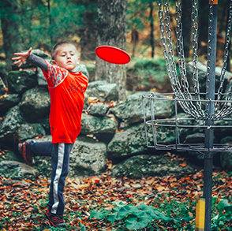
Growing Popularity
4,000 courses worldwide
Expanding demographic of participants
Notes:
There are very few places in the US that are farther than 50 miles away from a Frisbee golf course. I expect if I asked you guys to picture a disc golf player you would picture a white male, with long hair, wearing a tie dye t shirt. Probably just got back from a weekend trip to Colorado.

Slide 6
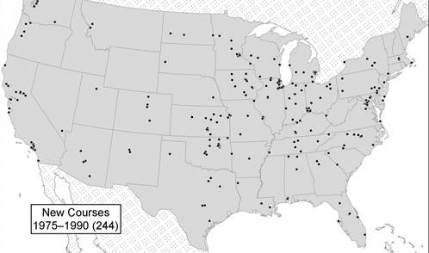
Diffusion of Disc Golf in US

Slide 7
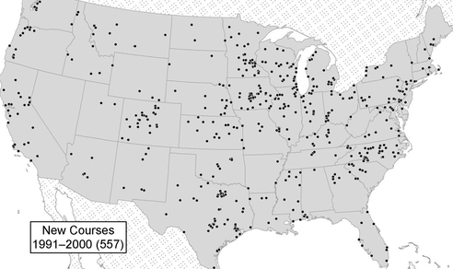

Slide 8
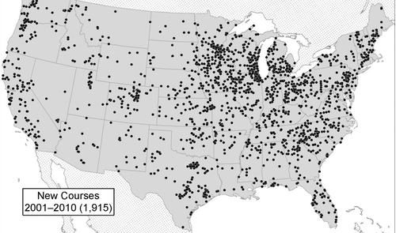
Notes:
Iowa is at the epicenter for Disc Golf in America. Later, in my research a couple local experts verified this notion. People in the state of Iowa are already participating.

Slide 9
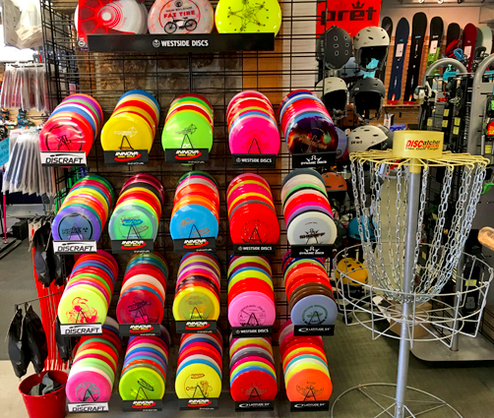
Generating Revenue
Notes:
There is a state park in Michigan that reports making $50,000 or more the previous 3 years from merchandise and course fees. Very few courses have course fees, because most are in publicly owned spaces and the relatively inexpensiveness is part of the fabric of the sport

Slide 10
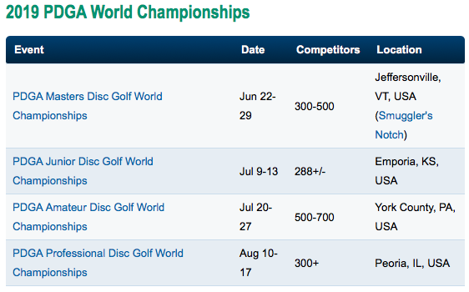
Notes:
Large tournaments can bring in hundreds of competitors, from all over the state and some from around the country.
These are some participant projections for some of PDGA’s major events in 2019. Don Williams Park certainly has the terrain, open space, and is aesthetically pleasing enough to hold a course of this caliber.

Slide 11
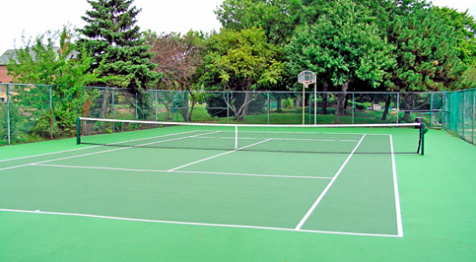
Eco-friendly
Notes:
Being a conservation group, obviously being environmentally friendly is a major part of this project. There is very little removal of trees and shrubbery to create space for a course. There is no need for pesticides or herbicides used frequently on traditional golf courses.

Slide 12
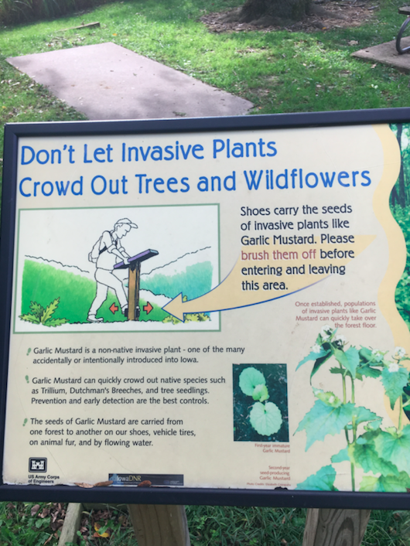
Player Involvement in Conservation
Notes:
Frisbee golf players maintain a culture of coexisting and appreciation of our natural spaces. It is sort of an unwritten rule to leave the course better than you found it, picking up trash or debris and disposing of it during a round. Many courses include signs like the one pictured above warning about the spread of invasive species or steps to not disturb natural habitat for wildlife.

Slide 13
Methods
Stakeholder Understanding
Notes:
I sent emails to my contact and executive director, Tanner Scheuermann. We discussed the current usage of Don Williams Park and their goals of increasing recreation participation and community involvement in conservation. Tanner mentioned that maintenance workers at the park has occasionally found Frisbees of campers who had played using trees as holes, which became the inspiration for this project.

Slide 14
Mission Statement
“To protect, conserve, and maintain our natural resources and provide education and recreation for the benefit of current and future generations.”
Notes:
Disc golf is an area where these ideals intersect

Slide 15
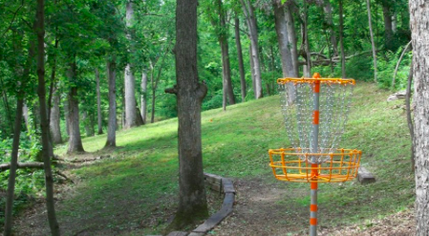
Course Research
Notes:
I had played a handful of rounds at my local 9-hole course in high school but that was the extent of my knowledge. I visited Sugar Bottom Disc Golf Course, Wetherby Disc Golf Course, and Peninsula Disc Golf Course in the month of September. At each course I took notes on the lengths of each hole, general course design, how the landscape and shrubbery was used. I also took pictures of signage and unique holes.

Slide 16
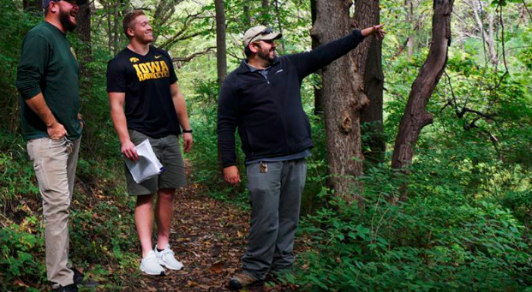
Site Visit
Notes:
On September 27th, accompanied by Kelly Carr form the Office of Outreach and Engagement, I traveled to the park for a first hand perspective of what opportunities the park had to offer. Tanner and Eric gave us a tour of the area where envisioned the course would begin and end, pointing out placement of potential holes, obstacles to work around, and areas of high traffic to avoid. After the tour he presented me a map of the park in its entirety.

Slide 17
Design Selection
We realized we couldn’t do it
Notes:
Having a conversation with Packy, my job isn't to design the course, its to make sure my stakeholder receives the best design

Slide 18
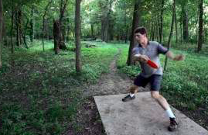
Jeff Harper
Pro Disc Golfer since 1985
  266 Pro events
  71 Wins
Notes:
He has designed courses all over the state, proved me valuable background information on the sport in the state of Iowa, and, Ultimately helped me make a lot of my recommendations. I should also mention Steve Kenton here as well, as he became Tanner’s main contact. He’s from Ames, has played professionally and worked with Jeff on multiple occasions.

Slide 19
Recommendations
ALL IN!!!!
Iowa is major hotbed for Frisbee golf
  279 courses listed on PDGA
  Held World championships twice
Notes:
After research into the value and practicality of creating a disc golf course at Don Williams, I truly believe it is the logical next step to take Don Williams Park to the next level in terms of usage, community involvement in conservation, and generating revenue for Boone County. Clearly, the population of active people in this state who enjoy the outdoors is already immersed in this sport. The renowned High Trestle Trail is within riding distance of Don Williams Park and adding disc golf could allow us to further tap into a number of people who enjoy the outdoors.

Slide 20
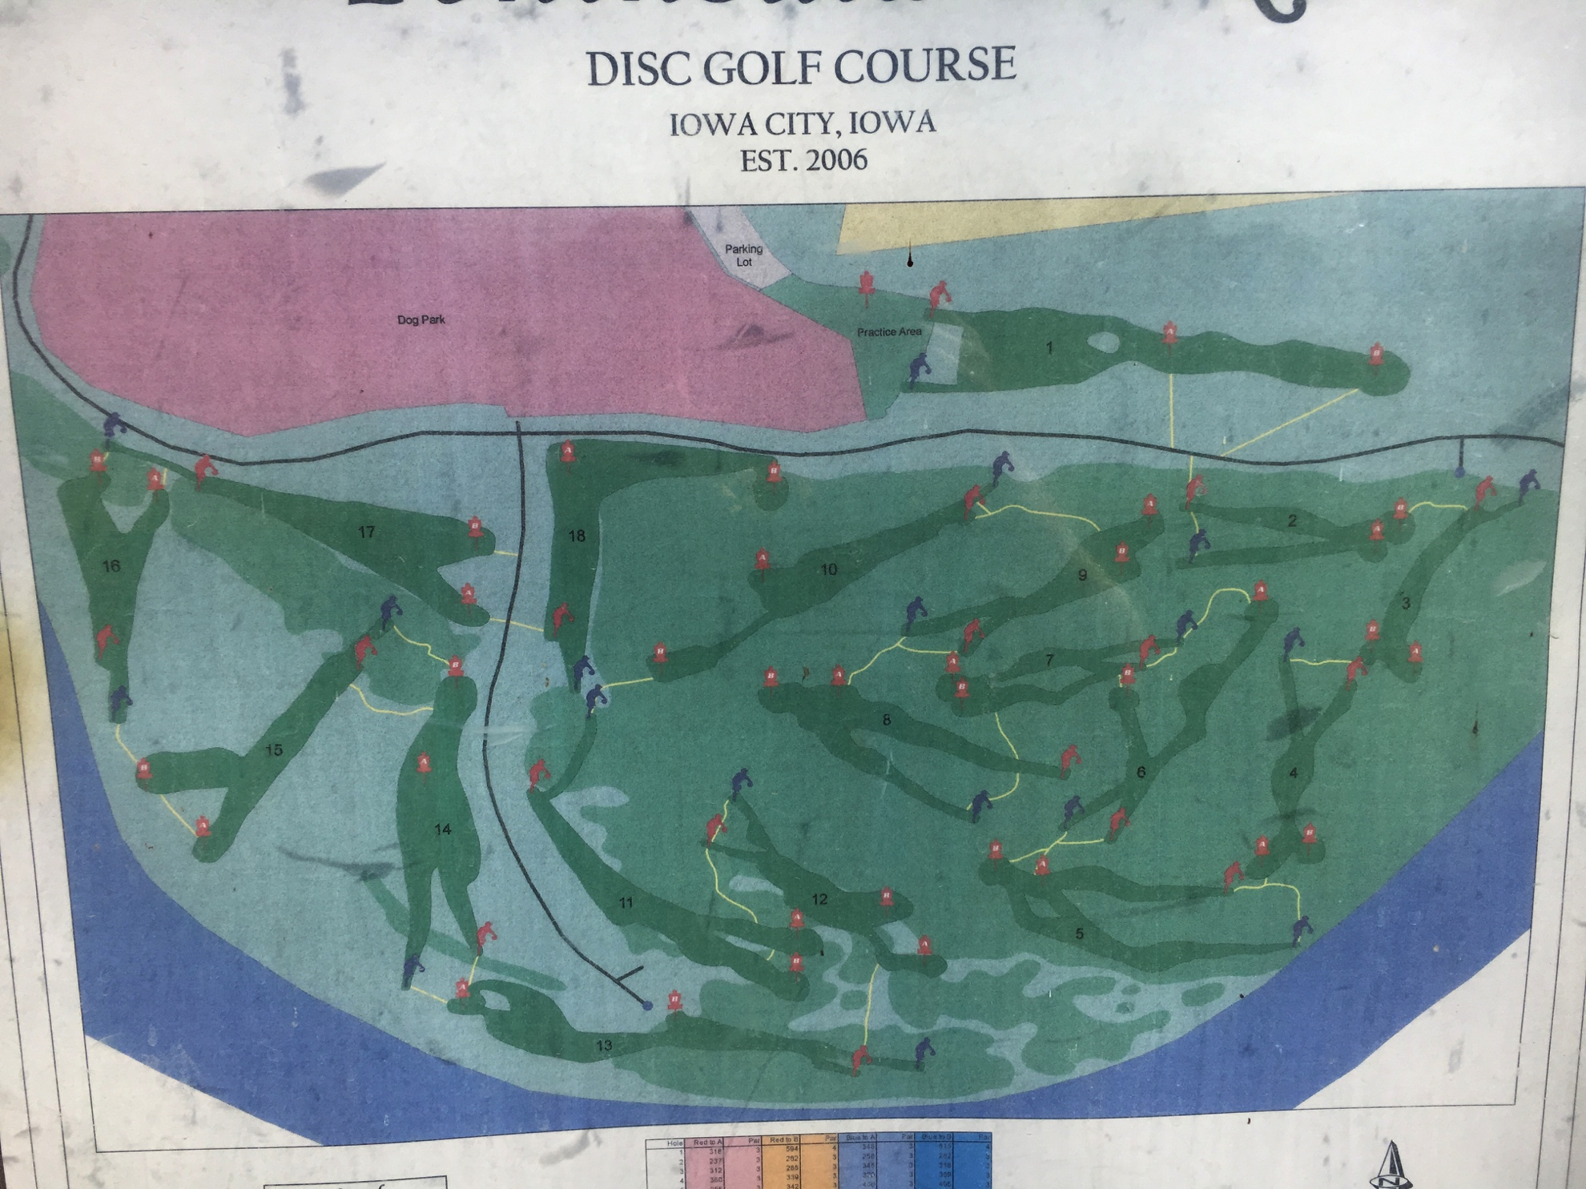
Peninsula Disc Golf Course

Slide 21
Peninsula Usage
In season
  40 rounds weekdays
  100+ weekends
Out of season
  10 rounds weekdays
  25 weekends
Hosts Pro/Pro-Am tournaments
Notes:
Already mentioned tournaments bring in hundreds, close to a thousand people. Got state championships year after it was built. Altmaier park got a pro am two weeks after opening

Slide 22
Cost Estimates
36 tee boxes: $170 x 36 = $6,120
36 baskets: $400 x 36 = $14,400
Signs and waste baskets: $90 x 18 = $1,620
= $22,140.00
Notes:
Area is already maintained, volunteers, BCC staff

Slide 23
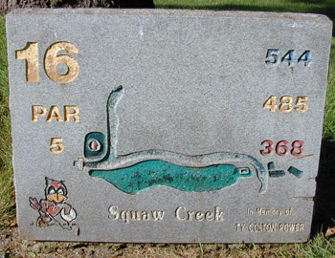
Offsetting Costs and Revenue
Hole memorial and sponsorship
Disc sales and rental
Merchandise
Notes:
New bait shop being built

Slide 24
Next Steps
Steve Kenton site visit
Timeline
Opening Tournament
Notes:
(Next year, Fiscal year ends June 2019)

Slide 25
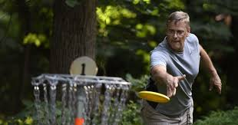
Questions?

